Slide 1
A/AN
Meaning: Without
Anaerobic – Without Air

Slide 2
Ab
Meaning: Away from
Abnormal -

Slide 3
The Opening Question 8/28
What are the Steps of the Scientific Method? (In Order)

Slide 4
The Opening Question

Slide 5
AD
Meaning: Near or Toward
Example: Adrenal

Slide 6
The Opening Question 8/29
Define independent & dependent variable.

Slide 7
Aero
Meaning: Air
Aerodynamic -

Slide 8
The Opening Question 8/30
How do we tell if something is alive?

Slide 9
Alb
Meaning: White
Albino

Slide 10
The Opening Question 8/31
How are photosynthesis and cellular respiration related?

Slide 11
Algia
Meaning: Pain
Nerualgia

Slide 12
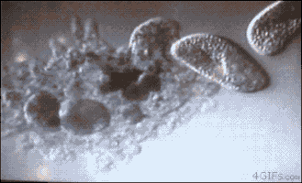
Ameb
Meaning: Change
Ameba
Ambidextrous

Slide 13
The Opening Question 9/5
What is the difference between a negative and a positive feedback loop?

Slide 14
Amphi
Meaning: Both
Amphibian

Slide 15
The Opening Question 9/6
When your blood glucose (sugar) is too high the brain sends a message to the pancreas to release insulin. The insulin lowers the glucose level.
What type of feedback loop is this?

Slide 16
Ana
Meaning: Again
Analysis

Slide 17
The Opening Question 9/7
What does Homeostasis mean? Give one example of how your body maintains it.

Slide 18
Anti
Meaning: Against
Antibiotic

Slide 19
Anthro
Meaning : Human
Anthropology

Slide 20
The Opening Question 9/11
List the Levels of Life from Smallest to Largest

Slide 21
The Opening Question 9/12
What are the 3 parts of the Cell Theory?

Slide 22
Annulus
Meaning: Ring shaped
Annual

Slide 23
The Opening Question 9/13
List 3 Organelles and their functions

Slide 24
Aqua
Meaning: Water
Aquatic

Slide 25
The Opening Question 9/14
What is the Endosymbiotic Theory?

Slide 26
Arachno
Meaning: Spider or Spider-like
Arachnophobia

Slide 27
The Opening Question 9/18
Why is the element Carbon so important for life?

Slide 28
Archae
Meaning: Ancient
Archaeology

Slide 29
The Opening Question 9/19
What are the 4 macromolecules (organic) that can be produced because of carbon?

Slide 30
Arthr
Meaning: joints or connecting bones
Arthritis

Slide 31
The Opening Question
What is One topic covered in Module One that you still don’t understand?

Slide 32
Ase
Meaning: an enzyme
( speeds up chemical reactions)
Lactase

Slide 33
The Opening Question 9/21
How much time have you spent studying for the Common Assessment?

Slide 34
Auto
Meaning: Self
automobile

Slide 35
The Opening Question 9/27
What are Van der Waals Forces? How do the impact molecules?

Slide 36
Bi
Meaning: Two or Twice
Bifocal

Slide 37
The Opening Question 9/26
What is the difference between an Ionic and a Covalent Bond?

Slide 38
Bio
Meaning: Life
Biology

Slide 39
The Opening Question
What is the relationship between monomers and polymers?

Slide 40
Biosis
Meaning: Mode or way of life
Symbiosis

Slide 41
The Opening Question 10/2
What is a Hydrogen Bond? Why is it so important to water?

Slide 42
Blast
Meaning: an immature cell
Osteoblast

Slide 43
The Opening Question 10/3
What are the 2 parts of a solution? Define each.

Slide 44
Bot
Meaning: Plant
Botany

Slide 45
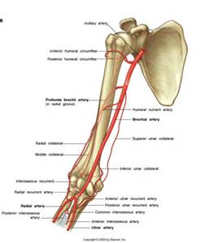
Brachi
Meaning: Arm
Brachial Artery

Slide 46
The Opening Question 10/6
A bug walking across the surface of the water can be explained using what 2 properties of water?

Slide 47
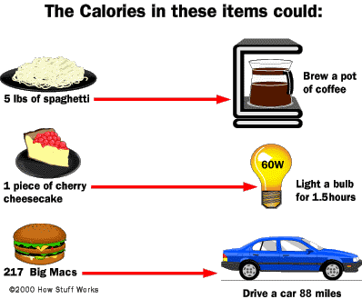
Calori
Meaning: Heat
Calories

Slide 48
The Opening Question 10/9
What is the job of an enzyme? What type of macromolecule is it?

Slide 49
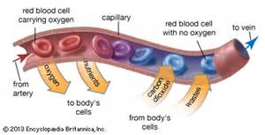
Capilli
Meaning: Hair (greek translation)
Capillary

Slide 50
The Opening Question 10/10
What is the difference between a Catabolic and an Anabolic reaction?

Slide 51
Card
Meaning: Heart
Cardiologist

Slide 52
The Opening Question 10/12
What factors impact the rate of Enzyme activity

Slide 53
Carn
Meaning: Flesh
Carnivore

Slide 54
The Opening Question 10/13
What happens to the enzymes rate of reaction when the solutions temperature is lowered? Why?

Slide 55
Caryo/Karyo
Meaning: Nucleus of a Cell
Eukaryote

Slide 56
The Opening Question 10/16
What is the difference between an Ionic and a covalent bond? Which one does carbon form?

Slide 57
Cata
Meaning: Decomposition
Catabolic

Slide 58
The Opening Question 10/17
List the 4 Macromolecules (biomolecules) and their jobs

Slide 59
Cephalo
Meaning: Head
Microcephaly

Slide 60
The Opening Question 10/18
What are the monomers of the 4 macromolecules.

Slide 61
The Opening Question 10/18 pt. 2
What is hydrolysis? What is dehydration synthesis?

Slide 62
Cerebro
Meaning: Brain
Cerebral

Slide 63
The Opening Question 10/23
What is a calorie? How many calories are there in one molecule of glucose?

Slide 64
Announcements
End of the 9 weeks is this week
Extended time tests due today
Make up tests due by Friday
Make up work by Thursday
WoD Check by Thursday

Slide 65
Chloro
Meaning: Green
Chloroplast

Slide 66
The Opening Question 10/24
What are the 3 stages of Cellular Respiration? How much ATP is made in each step?

Slide 67
Chondros
Meaning: Cartilage
Chondrocarcinoma

Slide 68
The Opening Questions 10/25
What is Fermentation? What is the difference between the two types?

Slide 69
Announcements
Make up work is due Thursday.
Tests must be finished by Friday (Thursday for 9th pd.)
WoD Checks

Slide 70
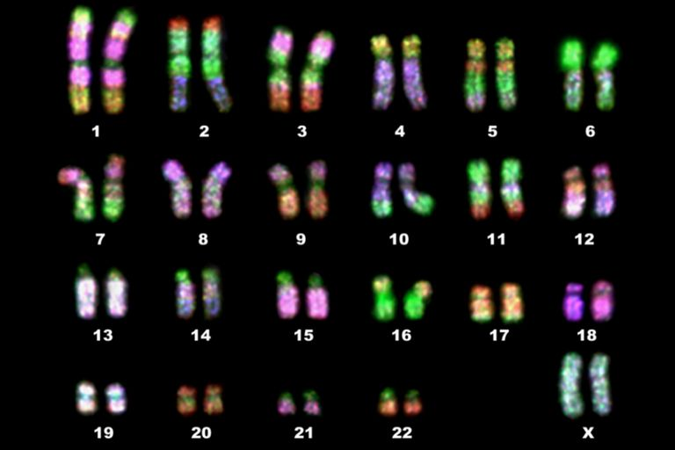
Chrom
Meaning: Color
Chromosomes

Slide 71
The Opening Question 10/26
Write the formula for Cellular Respiration.

Slide 72
Announcements
Common Assessment Make-Ups due by 12pm Friday
Make-Up Assignments due Today

Slide 73
Cide
Meaning: Kill
Insecticide

Slide 74
2nd 9 Weeks Updates
Goal: Increase what you remember day to day and in the module
How?
We will discuss the QoD at the end of class (must participate)
QoD sheets will be checked for correctness
I will update the ppt on the Website weekly
There will be a second QoD check of all papers & quiz of QoD questions before each common assessment.
You will know the questions and the answers you just need to memorize/ learn them.

Slide 75
The Opening Question 10/30
How is energy stored in ATP? How is it released?

Slide 76
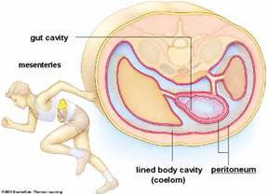
Coel
Meaning: Cavity
Coelom

Slide 77
The Question of the Day 10/31
What is phosphorylation? How is it used to recharge ATP?

Slide 79
Costa
Meaning: Rib
Intercostal Muscle

Slide 80
Question of the Day 11/2
What are ATPase and ATPsynthase? What does each do?

Slide 81
Cuti
Meaning: Skin
Subcutaneous

Slide 82
Question of the Day 11/2
What is fermentation? Why is it so important to life?

Slide 84
Cyst
Meaning: Capsule
Blastocyst

Slide 85
Question of the Day 11/8
What did the experiments of Priestly and Ingenhousz teach us about photosynthesis?

Slide 86
Cyto
Meaning: Cell
Cytokinesis

Slide 87
Question of the Day 11/9
What is a pigment? What role do the pigments chlorophyll a & b play in photosynthesis?

Slide 88
Question of the Day 11/ 9 part 3
What is the chemical equation for photosynthesis including coefficients?

Slide 89
Decid
Meaning: Cut off
Deciduous

Slide 90
Question of the Day 11/13
What occurs during the Calvin Cycle (the light independent reaction) of photosynthesis?

Slide 91
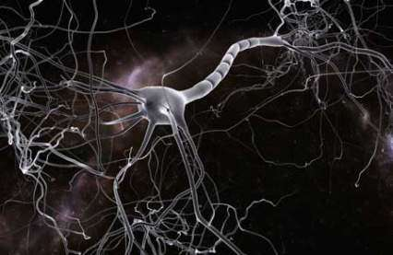
Dendr
Meaning: Tree like
Dendrite

Slide 92
Question of the Day 11/14
List the number of carbon, hydrogen, and oxygen atoms present in the photosynthesis and cellular respiration equations

Slide 93
Question of the Day 11/15
What is Cellular Respiration? What are the 3 Steps?

Slide 94
Dent/ Dont
Meaning: Tooth
Orthodontist

Slide 95
Announcements
All work from last week or before from Module 3 is Due
Anything from this week is Due Tuesday 11/20
Module 3 Vocab Check Tuesday
MODULE 3 Test is Monday/ Tuesday – makeups Wed on your time
You will need all Review Points to keep a good grade. Especially if you struggle on big tests

Slide 96
Question of the Day 11/16
What are the 3 Stages of Cell Respiration? What are the 2 Stages of Photosynthesis?

Slide 97
Derm
Meaning: Skin
Epidermis

Slide 98
Question of the Day 11/28
What is concentration? How does it relate to the movement of materials without energy?

Slide 99
Di
Meaning: Two
Carbon Dioxide

Slide 100
Question of the Day 11/29
What is the composition of the Cell Membrane? How does this allow it to act as a Semipermeable Membrane?

Slide 101
Dia
Meaning: Through, Across
Diameter

Slide 102
Question of the Day 11/30
What are the three words used to describe a solution? Describe the amount of solute found in each.

Slide 103
Diplo
Meaning: Double
Diploid Cell

Slide 104
Question of the Day 11/4
Compare and contrast diffusion and osmosis.

Slide 105
Dis
Meaning: Apart or Away
Dissolve

Slide 106
Dorso
Meaning: Back
Dorsal Fin

Slide 107
Echnio (Spelled wrong on your paper
Meaning Spiny
Echinoderm

Slide 108
Question of the Day 12/7
What is the difference between active and passive transport? When would each occur?

Slide 109
Eco
Meaning: House (living place)
Ecology

Slide 110
Ecto
Meaning: Outer
Ectoderm

Slide 111
Question of the Day 12/11
What is Osmosis? What changes would you make to the osmosis lab?

Slide 112
Ectomy
Meaning: Removal
Appendectomy

Slide 113
Question of the Day 12/12
What is the role of cholesterol in the cell membrane?

Slide 114
Emia
Meaning: Blood
Anemia

Slide 115
Question of the Day 12/13
What is Turgor Pressure? How does it explain what happens to plants when you don’t water them?

Slide 116
Endo
Meaning: Inner
Endocytosis

Slide 117
Question of the Day 12/14
What is the difference between a Channel Protein, Carrier Protein & a Glycoprotein.

Slide 119
Enter
Meaning: Intestine
Enteric

Slide 122
Epi
Meaning: Above
Epidermis

Slide 125
QUESTION OF THE DAY 1 - 2
What Problems can growth case for cells?

Slide 126
Erythro
Meaning: Red
Erythrocyte

Slide 127
Question of the Day 1/4
What happens during Mitosis? List the Stages in Order

Slide 128
Eu
Meaning: True
Eukaryote

Slide 129
Question of the Day 1-8
Compare and contrast Chromosomes and Chromatids.

Slide 131
Ex
Meaning: Outside
Exocytosis

Slide 133
Extra
Meaning: outside
Extracellular

Slide 134
Question of the Day 1-10
What is the role of the centrioles and spindle fibers in Mitosis?

Slide 135
Mitosis Slide Assignment
Number 1-8
Write the name of the Stage
Provide evidence that led you to this conclusion ( 1-2 sentences using Mitosis terms)

Slide 136
Fer
Meaning: Carry
Transfer

Slide 137
Question of the Day 1/11
Whose cells divide quicker, prokaryotes or eukaryotes? Why is this possible? What are the consequences?

Slide 138
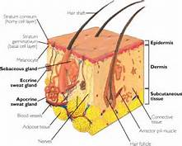
Folli
Meaning: “Bag”
Follicle

Slide 139
Question of the Day 1/16
What is one characteristics of all living things?

Slide 140
Gam
Meaning: Union
Gamete

Slide 141
Question of the Day 1/17
Name one of the Biomolecules, its function, and the elements it’s composed of.

Slide 142
Gamy
Meaning: Marriage
Monogamy

Slide 143
Question of the Day 1/18
Compare and contrast photosynthesis and cellular respiration.

Slide 144
Gastro
Meaning: Stomach
Gastritis

Slide 145
Question of the Day 1/19
What is the role of cholesterol in the Cell Membrane? Why is it found in larger amounts in aquatic organisms in cold regions?

Slide 146
Gen
Meaning: Made / Same
Generation

Slide 147
Question of the Day 1/22
What mechanisms regulate the cell cycle?

Slide 148
Geo
Meaning: Earth
Geology

Slide 149
Question of the Day 1/24
What is the final product of Meiosis? How does this differ from Mitosis?

Slide 150
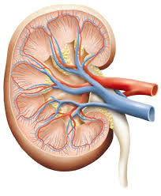
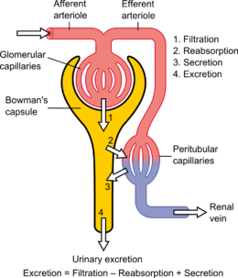
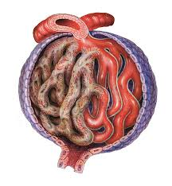
Glomus
Meaning: Ball
Glomerulus

Slide 151
Question of the Day 1/25
What is the difference between a Diploid & Haploid Cell. Which is produced in Mitosis? In Meiosis?

Slide 152
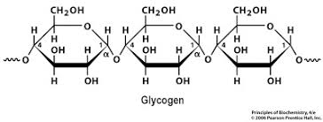
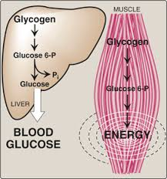
Glycys
Meaning: Sweet/sugar
Glycogen

Slide 153
Question of the Day 1/26
What is the role of the Crossing Over during Meiosis? Why is this important?

Slide 154
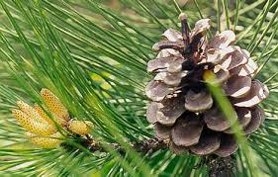
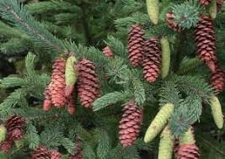
Gymonos
Meaning: Naked
Gymnosperm

Slide 155
Question of the Day 1/29
Describe the similarities and differences between Meiosis I and Meiosis II.

Slide 156
Meiosis Pictionary
Each group will receive a post-it with the name of a meiosis stage ( don’t show the rest of the class)
Draw it on a piece of blank paper ( again…don’t share)
1 group member from each group will take turns going to the board to draw their picture.
The first group to correctly identify it gets a point (1 guess per team)
The team with the most points will get a bonus point a piece.

Slide 157
Gyn
Meaning: Female
Gyniatrics

Slide 158
Question of the Day 1/30
What is the difference between a haploid, a diploid, and a zygote?

Slide 159
Haplo
Meaning: Single
Haploid

Slide 160
Question of the Day 1/31
Compare and contrast the production of the sperm and egg gametes.

Slide 161
Review Project: Cell Cycle Comic
Using the provided templates design and create a comic the explains the cell cycle.
This should include ALL stages of Interphase, Mitosis, & Meiosis I and II
The stages should be explained.
All features and vocabulary should be included
This will be graded for completeness and Bonus will only be awarded to projects that go above and beyond.

Slide 162
Hemi
Meaning: Half
Hemisphere

Slide 163
Question of the Day2/1
What Happens during Crossing Over? Why is it so important?

Slide 164
Hemo
Blood
Hemophilia

Slide 165
Question of the Day 2-2
What would happen if the genes did not separate evenly between the gametes during meiosis?

Slide 166
Hepato
Meaning: Liver
Hepatitis

Slide 167
Question of the Day 2/5
What is Genetics? Describe the first experiments in this field.

Slide 168
Helmis
Meaning: Worm
Platyhelminthes

Slide 169
Question of the Day 2-6
What did Mendel mean when he said genes are segregated?

Slide 170
Herpeto
Meaning: Reptile
Herpetology

Slide 171
Hetero
Meaning: Other / Different
Heterotroph

Slide 172
Question of the Day 2-13
What do you understand about the current topic? What is still confusing?

Slide 173
Horto
Meaning: Garden
Horticulture

Slide 174
Question of the Day 2-14
In mice, white hair is dominant to grey hair. What is the probability of getting a grey haired mouse when a homozygous dominant and a homozygous recessive mouse are crossed?

Slide 175
Homo
Meaning: Same
Homozygous

Slide 176
Question of the Day 2-15
What is the difference between Incomplete & Codominance? Give an example of each.

Slide 177
Homo
Meaning: Human Being
Homo sapiens

Slide 178
Question of the Day 2/19
Explain why Blood Type is considered a Codominant trait.

Slide 179
Hydro
Meaning: Water
Hydrolysis

Slide 180
Question of the Day 2/20
If a male with Homozygous A blood and a female with Homozygous B blood have children what will be their blood types? Is this incomplete or codominance?

Slide 181
Hyper
Meaning: Above
Hyperglycemia

Slide 182
Question of the Day 2/21
How are dihybrid crosses different from monohybrid crosses?
What Mendelian Conclusion explains the possibility of Dihybrid crosses?

Slide 183
Hypo
Meaning: Under
Hypothermia

Slide 184
Question of the Day 2/22
If a person needed a transfusion what blood type would be the easiest to give donation to? What would be the hardest?
(Be specific blood type & +/-

Slide 185
ia
Meaning: Disease
Pneumonia

Slide 186
Question of the Day 2/23
What would you expect to be closer to the results of a punnett square 10 or 50 trials of the cross?

Slide 187
Inter
Meaning: Between
Interstate

Slide 188
Question of the Day 2/26
What is a sex-linked trait? Who is more likely to get it? Why?

Slide 189
iso
Meaning: equal
Isotonic

Slide 190
Question of the Day 2/27
What is the purpose of a pedigree chart?

Slide 191
ite
Meaning: Division or Part
Composite

Slide 192
Question of the Day 2/28
How can you tell the difference between an Autosomal Dominant and Autosomal Recessive trait on a Pedigree Chart?

Slide 193
Itis
Inflammation
Arthritis

Slide 194
Question of the Day 3/1
How can you tell the difference between an Autosomal and a Sex-Linked trait on a pedigree chart?

Slide 195
intra
Meaning: Within
Intraspecies

Slide 196
Question of the Day 3/2
A pedigree contains half filled shapes of both genders. Is the trait autosomal or x-linked? Dominant or Recessive? How do you know?

Slide 197
Lac
Meaning: Milk
Lactose

Slide 199
Leuko
Meaning: White
Leukocyte

Slide 202
Latero
Meaning: Side
Lateral

Slide 205
Logy
Meaning: Study of
Biology

Slide 208
Lyso
Meaning: Dissolve
Lysosome

Slide 211
Mal
Meaning: Bad
Malnutrition

Slide 214
Mega
Meaning: very large
Megadose

Slide 217
Meso
Meaning Middle
Mesoderm

Slide 220
Menstruus
Meaning: Monthly
Menstrual

Slide 223
Micro
Meaning: Small
Microbe

Slide 226
Mito
Meaning: Thread
Mitosis

Slide 229
Molluscus
Meaning: Soft
Mollusca

Slide 232
Mono
Meaning : One
Monocular

Slide 235
Morph
Meaning: Form or shape
Morphology

Slide 238
Myo
Meaning: Muscle
Myocardial

Slide 241
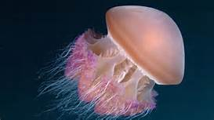
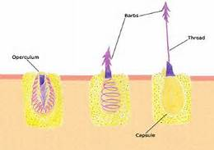
Nema
Meaning: Thread
Nematocyte

Slide 244
Nephr
Meaning: Kidney
Nephritis

Slide 247
Neuro
Meaning: Nerve
Neurosurgeon

Slide 250
Nocti
Meaning: Night
Nocturnal

Slide 253
Oma
Meaning: Tumor
Carcinoma

Slide 256
Omni
Meaning: All
Omnivore

Slide 257
Oo
Meaning: Egg
Oogenesis

Slide 258
Ophth
Meaning: Eye
Ophthalmology

Slide 259
Osis
Meaning: Condition
Osteoporosis

Slide 260
Osteo
Meaning: Bone
Osteocyte

Slide 261
Oto
Meaning: Ear
Otitis

Slide 262
Ovi
Meaning: Egg
Oviduct

Slide 263
Ose
Meaning: Sugar
Glucose

Slide 264
Para
Meaning: Beside
Parathyroid

Slide 265
Patho
Meaning: Disease
Pathology

Slide 266
Ped/pod
Meaning: Foot
Millipede

Slide 267
Peri
Meaning: Around
Pericardium

Slide 268
Phago
Meaning: Eating
Phagocytosis

Slide 269
Phase
Meaning: Stage
Metaphase

Slide 270
Pheno
Meaning: Show
Phenotype

Slide 271
Photo
Meaning: Light
Photosynthesis

Slide 272
Phyll
Meaning: Leaf
Chlorophyll

Slide 273
Phyto
Meaning: Plant
Saprophyte

Slide 274
Pino
Meaning: Drink
Pinocytosis

Slide 275
Plasma
Meaning: Form
Cytoplasm

Slide 276
Plast
Meaning: Particle
Chloroplast

Slide 277
Platys
Meaning: Flat
Platyhelminthes

Slide 278
Pneuma
Meaning: Breathe
Pneumonia

Slide 279
Poly
Meaning: Many
Polygon

Slide 280
Poro
Meaning: Opening
Osteoporosis

Slide 281
Post
Meaning: After
Posterior

Slide 282
Pre
Meaning: Before
Premedatated

Slide 283
Pri
Meaning: First
Primary

Slide 284
Pseudo
Meaning: False
Pseudoscience

Slide 285
Pulmo
Meaning: Lung
Pulmonary

Slide 286
Re
Meaning: Again
Rerun

Slide 287
Renal
Meaning: Kidney
Adrenal

Slide 288
Rhea
Meaning: Discharge
Diarrhea

Slide 289
Rhino
Meaning: Nose
Rhinoceros

Slide 290
Rhizo
Meaning: Root
Rhizome

Slide 291
Sal
Meaning: Salt
Saline

Slide 292
Sclero
Meaning: Hard
Arteriosclerosis

Slide 293
Semi
Meaning: Partly
Semipermeable

Slide 294
Soma
Meaning: Body
Chromosome

Slide 295
Sperma
Meaning: Seed
Gymnosperm

Slide 296
Spirare
Meaning: To Breathe
Respiration

Slide 297
Stoma
Meaning: Opening
Stomata

Slide 298
Stasis
Meaning: Balance
Homeostasis

Slide 299
Stat
Meaning: Stationary
Hemostat

Slide 300
Succedere
Meaning: Follow
Succession

Slide 301
Syn
Meaning: Together
Photosynthesis

Slide 302
Taxo
Meaning: Arrangement
Taxonomy

Slide 303
Tele
Meaning: End
Telephase

Slide 304
Tetra
Meaning: Four
Tetrapod

Slide 305
Therapia
Meaning: Nurse
Therapy

Slide 306
Therm
Meaning: Heat
Thermometer

Slide 307
Thrombos
Meaning: Clot
Thrombosis

Slide 308
Tithenia
Meaning: Place
Synthesis

Slide 309
Trans
Meaning: Across
Transfer

Slide 310
Tri
Meaning: Three
Triploid

Slide 311
Trop
Meaning: Turn
Phototropic

Slide 312
Troph
Meaning: Nourishment
Photoautotroph

Slide 313
Vacca
Meaning: Cow
Vaccination

Slide 314
Vacuus
Meaning: Empty
Vacuole

Slide 315
Vaso
Meaning: Vessel
Cardiovascular

Slide 316
Venter
Meaning: Belly
Ventral

Slide 317
Viv
Meaning: Living
Viviparous

Slide 318
Vore
Meaning: Eat
Carnivore

Slide 319
Vertebra
Meaning: Backbone
Vertebrate

Slide 320
Xanthos
Meaning: Yellow
Xanthophylls

Slide 321
Xeros
Meaning: Dry
Xerophyte

Slide 322
Zoo
Meaning: Animal
Zoology

Slide 323
Zyg
Meaning: United
Zygote

