Slide 1
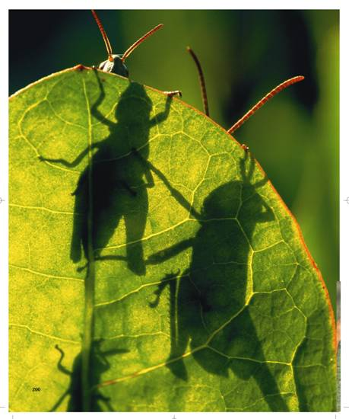
8-2 Photosynthesis: An Overview

Slide 2
8-2 Photosynthesis: An Overview
Photosynthesis - green plants use the energy of sunlight to convert water and carbon dioxide into high-energy carbohydrates and oxygen.

Slide 3
Investigating Photosynthesis
Van Helmont’s Experiment - 1600s
Q: do plants grow by taking material from the soil.
- Planted the seeds in the pot, and watered it regularly.
- Five years later, it was a small tree and had gained 75 kg, but the soil’s mass was unchanged.

Slide 4
Investigating Photosynthesis
A:The gain in mass came from water
Accounts for the “hydrate”, of the carbohydrate produced by photosynthesis.
Where does the carbon come from?

Slide 5
Investigating Photosynthesis
Priestley’s Experiment - 1700’s
Took a candle, placed a glass jar over it, and watched as the flame gradually died out.
The flame needed oxygen to keep burning and when it was used up, the flame went out.

Slide 6
Investigating Photosynthesis
Priestley placed a live sprig of mint under the jar
He found that the candle would remain lit for a while.
The mint plant had produced oxygen.

Slide 7
Investigating Photosynthesis
Jan Ingenhousz
Showed that the effect observed by Priestley occurred only when the plant was exposed to light.
Priestley’s and Ingenhousz’s experiments showed that light is necessary for plants to produce oxygen.

Slide 8
The Photosynthesis Equation
The Photosynthesis Equation
The equation for photosynthesis is:
6CO₂ + 6H₂O C₆H₁₂O₆ + 6O₂
carbon dioxide + water sugars + oxygen
Light
Light

Slide 9
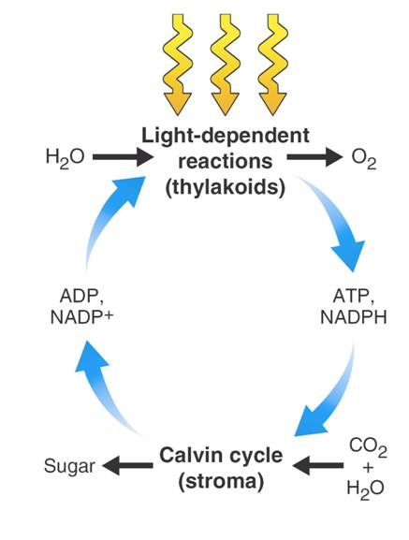
The Photosynthesis Equation
Light energy
H₂O
Light-Dependent Reactions (thylakoids)
O₂
ADP NADP⁺
ATP NADPH
CO₂ + H₂0
Sugar
Calvin Cycle (stroma)
Notes:
Photosynthesis is a series of reactions that uses light energy from the sun to convert water and carbon dioxide into sugars and oxygen.

Slide 10
Light and Pigments
Light and Pigments
How do plants capture the energy of sunlight?

Slide 11
Light and Pigments
Plants gather the sun's energy with light-absorbing molecules called pigments.
The main pigment in plants is chlorophyll.
There are two main types of chlorophyll:
chlorophyll a
chlorophyll b

Slide 12
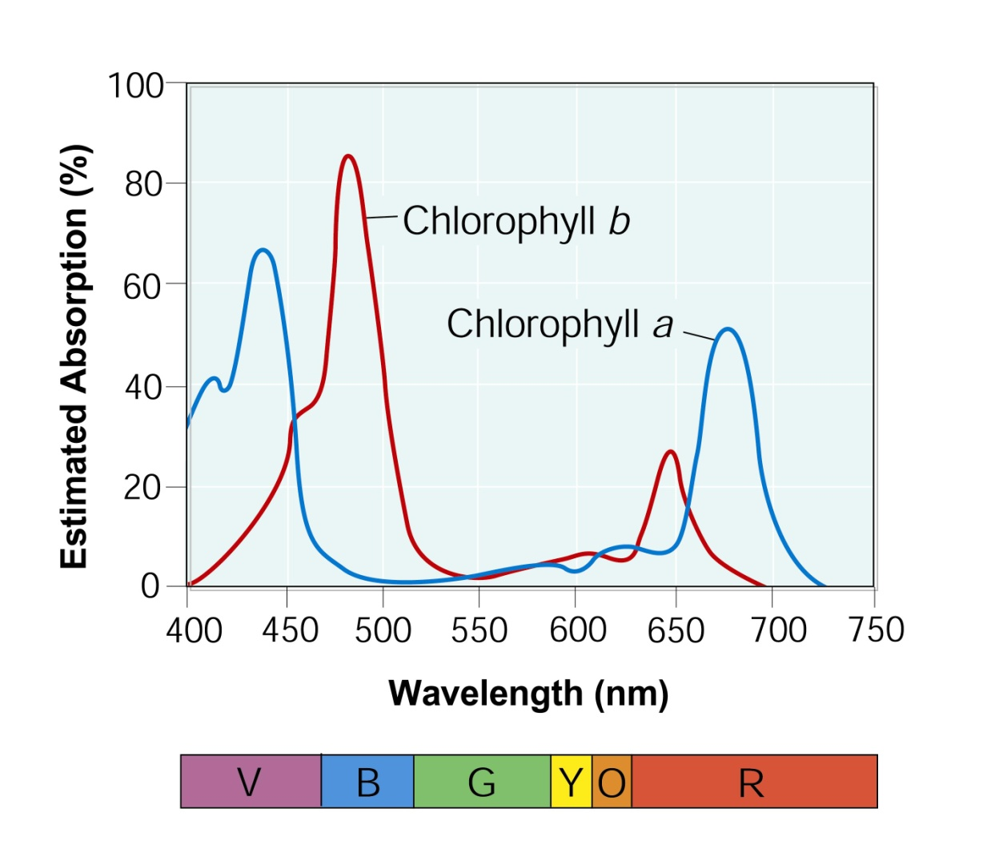
Light and Pigments
Chlorophyll absorbs light well in the blue-violet and red regions of the visible spectrum.
100
80
60
40
20
0
Chlorophyll b
Estimated Absorption (%)
Chlorophyll a
Wavelength (nm)
400 450 500 550 600 650 700 750
Wavelength (nm)
Notes:
Photosynthesis requires light and chlorophyll. In the graph above, notice how chlorophyll a absorbs light mostly in the blue-violet and red regions of the visible spectrum, whereas chlorophyll b absorbs light in the blue and red regions of the visible spectrum.

Slide 13
Light and Pigments
Chlorophyll does not absorb light will in the green region of the spectrum. Green light is reflected by leaves, which is why plants look green.
100
80
60
40
20
0
Chlorophyll b
Estimated Absorption (%)
Chlorophyll a
400 450 500 550 600 650 700 750
Wavelength (nm)
Notes:
Photosynthesis requires light and chlorophyll. In the graph above, notice how chlorophyll a absorbs light mostly in the blue-violet and red regions of the visible spectrum, whereas chlorophyll b absorbs light in the blue and red regions of the visible spectrum.

Slide 14
Light and Pigments
Light is a form of energy, so any compound that absorbs light also absorbs energy from that light.
When chlorophyll absorbs light, much of the energy is transferred directly to electrons in the chlorophyll molecule, raising the energy levels of these electrons.
These high-energy electrons are what make photosynthesis work.

Slide 15
8-2

Slide 16
8-2
In van Helmont's experiment, most of the added mass of the tree came from
soil and carbon dioxide.
water and carbon dioxide.
oxygen and carbon dioxide.
soil and oxygen.

Slide 17
8-2
Plants use the sugars produced in photosynthesis to make
oxygen.
starches.
carbon dioxide.
protein.

Slide 18
8-2
The raw materials required for plants to carry out photosynthesis are
carbon dioxide and oxygen.
oxygen and sugars.
carbon dioxide and water.
oxygen and water.

Slide 19
8-2
The principal pigment in plants is
chloroplast.
chlorophyll.
carotene.
carbohydrate.

Slide 20
8-2
The colors of light that are absorbed by chlorophylls are
green and yellow.
green, blue, and violet.
blue, violet, and red.
red and yellow.

Slide 21
END OF SECTION

