Slide 1
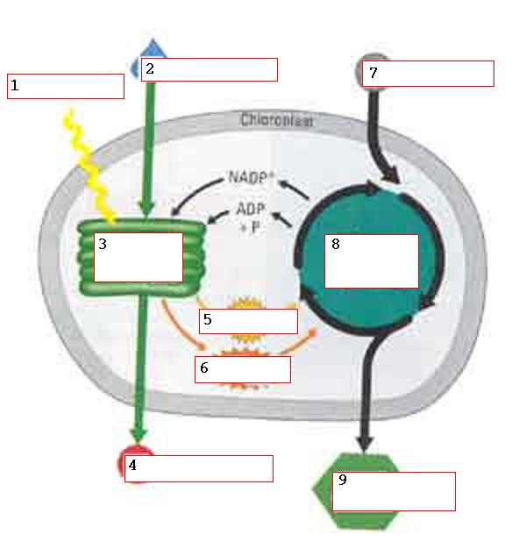

Slide 2
Light

Slide 3
H₂O
Light

Slide 4
H₂O
Light
Photosystems
ETC

Slide 5
H₂O
Light
Photosystems
ETC
O₂

Slide 6
H₂O
Light
Photosystems
ETC
ATP
O₂

Slide 7
H₂O
Light
Photosystems
ETC
ATP
NADPH
O₂

Slide 8
H₂O
Light
CO₂
Photosystems
ETC
ATP
NADPH
O₂

Slide 9
H₂O
Light
CO₂
Photosystems
ETC
Calvin Cycle
ATP
NADPH
O₂

Slide 10
H₂O
Light
CO₂
Photosystems
ETC
Calvin Cycle
ATP
NADPH
O₂
Sugar

