Slide 1
Chapter 12
The Cell Cycle
The life of a cell and what happens when it loses control

Slide 2
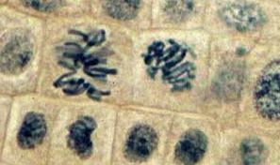
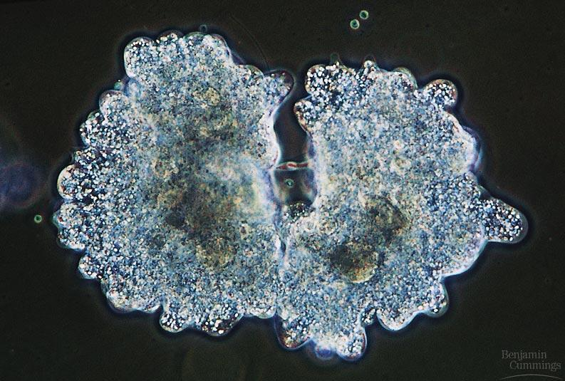
Biology is the only subject in which multiplication is the same thing as division…
2007-2008
Notes:
*

Slide 3
Where it all began…
You started as a cell smaller than a period at the end of a sentence…
Notes:
*

Slide 4
And now look at you…
How did you get from there to here?
Notes:
*

Slide 5
Getting from there to here…
Going from egg to baby….
the original fertilized egg has to divide…
and divide…
and divide…
and divide…

Slide 6
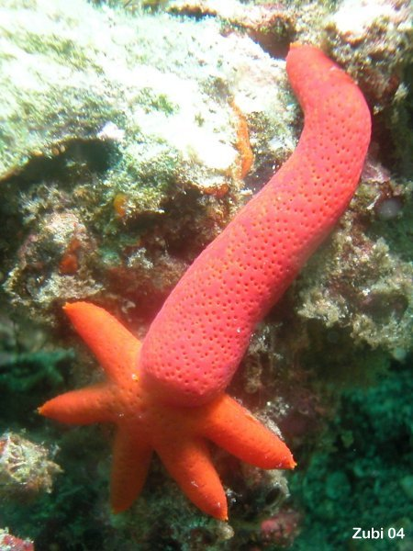
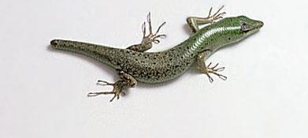
Why do cells divide?
For reproduction
asexual reproduction
one-celled organisms
For growth
from fertilized egg to multi-celled organism
For repair & renewal
replace cells that die from normal wear & tear or from injury
amoeba
Notes:
*
Unicellular organisms
Cell division = reproduction
Reproduces entire organism& increase population
Multicellular organisms
Cell division provides for growth & development in a multicellular organism that begins as a fertilized egg
Also use cell division to repair & renew cells that die from normal wear & tear or accidents

Slide 7
Cell division results in genetically identical daughter cells
Cells duplicate their genetic material before they divide, ensuring that each daughter cell receives an exact copy of the genetic material, DNA
A dividing cell duplicates its DNA, allocates the two copies to opposite ends of the cell, and only then splits into daughter cells
A cell’s DNA (its genetic information) is called its genome
DNA molecules in a cell are packaged into chromosomes

Slide 8
Every eukaryotic species has a characteristic number of chromosomes in each cell nucleus
Somatic (nonreproductive) cells have two sets of chromosomes (2n = diploid)
Gametes (reproductive cells) have half as many chromosomes as somatic cells (n = haploid)
Eukaryotic chromosomes consist of chromatin, a complex of DNA and protein that condenses during cell division

Slide 9
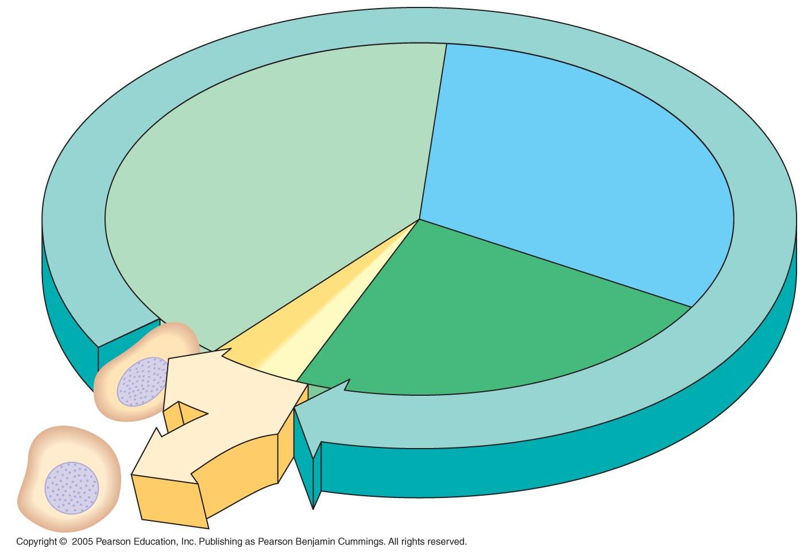
The Cell Cycle
INTERPHASE
G₁
S
(DNA synthesis)
Mitosis
Cytokinesis
G₂
MITOTIC
(M) PHASE

Slide 10
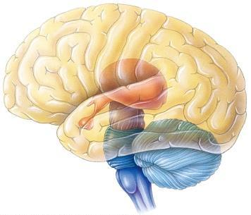
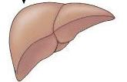
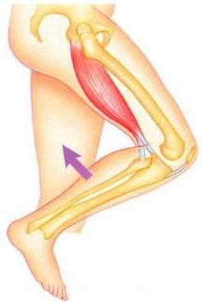
Cell cycle
Cell has a “life cycle”
cell is formed from a mitotic division
cell grows & matures
to divide again
cell grows & matures to never divide again
G₁, S, G₂, M
liver cells
G₁→G₀
epithelial cells, blood cells,
stem cells
brain / nerve cells
muscle cells
Notes:
*

Slide 11
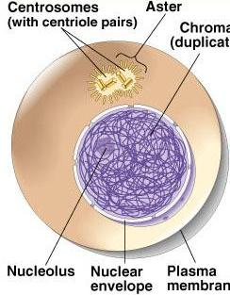
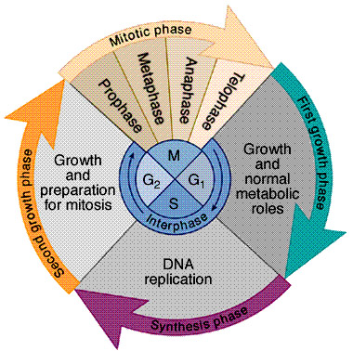
Interphase (90% of cell life is spent in this phase) G1- S – G2
Nucleus well-defined
DNA loosely packed in long chromatin fibers
Interphase - 3 phases:
G₁ = 1st Gap (Growth)
- cell doing its “everyday job”
- cell grows
S = DNA Synthesis
- copies chromosomes
G₂ = 2nd Gap (Growth)
- prepares for division
- makes more organelles, proteins, membranes
G₀
Notes:
*

Slide 12
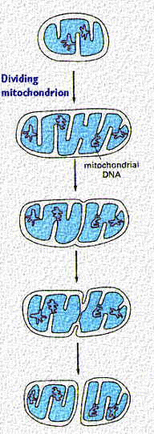
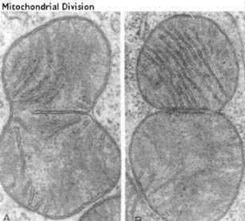
Mitochondrial Division:
Organelles do it too!

Slide 13
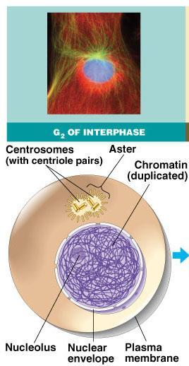
Interphase
green = key features
Nucleus well-defined
DNA loosely packed in long chromatin fibers
Prepares for mitosis
replicates chromosome
DNA & proteins
produces proteins & organelles
Notes:
*

Slide 14
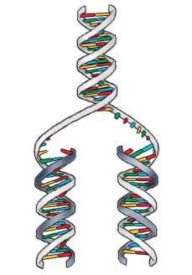
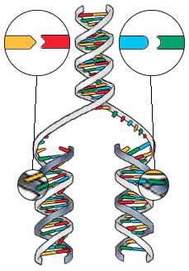
S phase: Copying / Replicating DNA
Synthesis phase of Interphase
dividing cell replicates DNA
must separate DNA copies correctly to 2 daughter cells
human cell duplicates ~3 meters DNA
each daughter cell gets complete identical copy
error rate = ~1 per 100 million bases
3 billion base pairs in mammalian genome
~30 errors per cell cycle
mutations (to somatic (body) cells)
Notes:
*

Slide 15
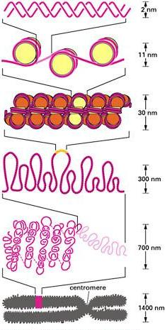
Organizing DNA
ACTGGTCAGGCAATGTC
DNA is organized in chromosomes
double helix DNA molecule
wrapped around histone proteins
like thread on spools
DNA-protein complex = chromatin
organized into long thin fiber
condensed further during mitosis
DNA
histones
chromatin
double stranded chromosome
duplicated mitotic chromosome
Notes:
*

Slide 16
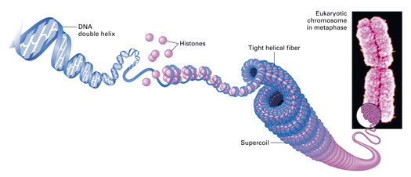
S phase: Replicating and packaging DNA
After DNA duplication, chromatin condenses
coiling & folding to make a smaller package
mitotic chromosome
DNA
chromatin
Notes:
*

Slide 17
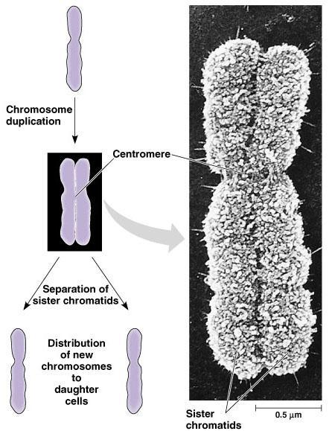
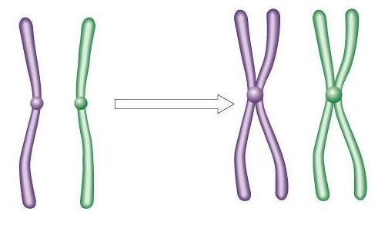
Mitotic Chromosome
Duplicated chromosome
2 sister chromatids
narrow at centromeres
contain identical copies of original DNA
homologous
chromosomes
homologous
chromosomes
single-stranded
sister chromatids
double-stranded
homologous = “same information”
Notes:
*
Centromeres are segments of DNA which have long series of tandem repeats = 100,000s of bases long. The sequence of the repeated bases is quite variable. It has proven difficult to sequence.

Slide 18
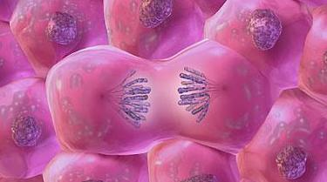
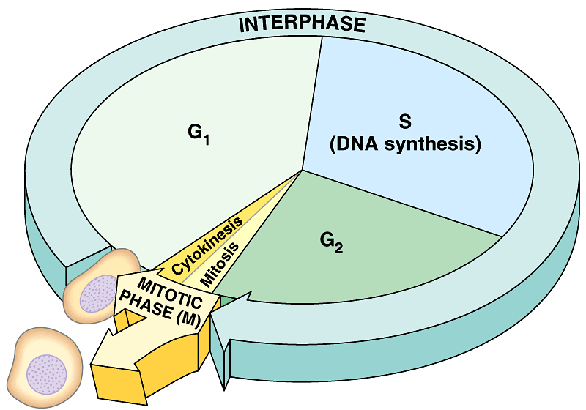
Mitosis
Dividing cell’s DNA between 2 daughter nuclei
5 phases
Prophase
prometaphase
metaphase
anaphase
telophase
Notes:
*

Slide 19
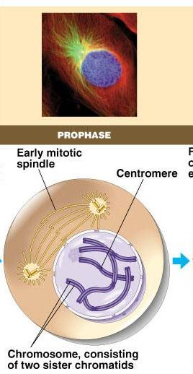
Prophase
green = key features
Chromatin condenses
visible chromosomes with chromatids
Centrosomes (with centrioles) move to opposite poles of cell (animal cell)
Protein fibers make the mitotic spindle (actin, myosin0
Nucleolus disappears
Nuclear membrane breaks down
Notes:
*

Slide 20
The Mitotic Spindle
The mitotic spindle is an apparatus of microtubules that controls chromosome movement during mitosis
Assembly of spindle microtubules begins in the centrosome, the microtubule organizing center
The centrosome replicates, forming two centrosomes(each centrosome consist of 2 centrioles) that migrate to opposite ends of the cell, as spindle microtubules grow out from them
An aster (a radial array of short microtubules) extends from each centrosome
The spindle apparatus includes the centrosomes, the spindle microtubules, and the asters

Slide 21
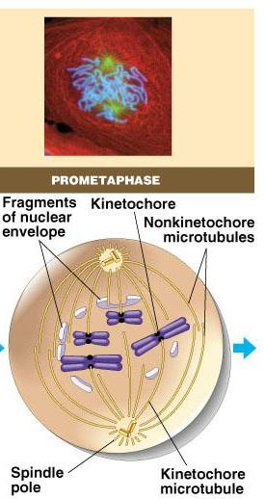
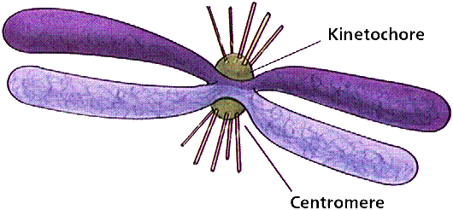
Transition to Metaphase
Prometaphase
spindle fibers attach to centromeres creating kinetochores
microtubules attach at kinetochores
connect centromeres to centrioles
chromosomes begin moving
Notes:
*

Slide 22
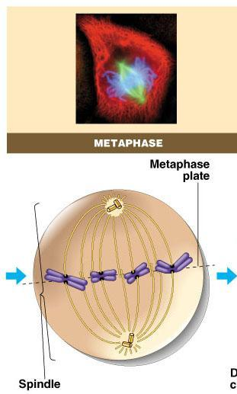
Metaphase
Chromosomes align along middle of cell
metaphase plate
spindle fibers coordinate movement
helps to ensure chromosomes separate properly
each new nucleus receives only 1 copy of each chromosome
(one sister chromatid)
Notes:
*

Slide 23
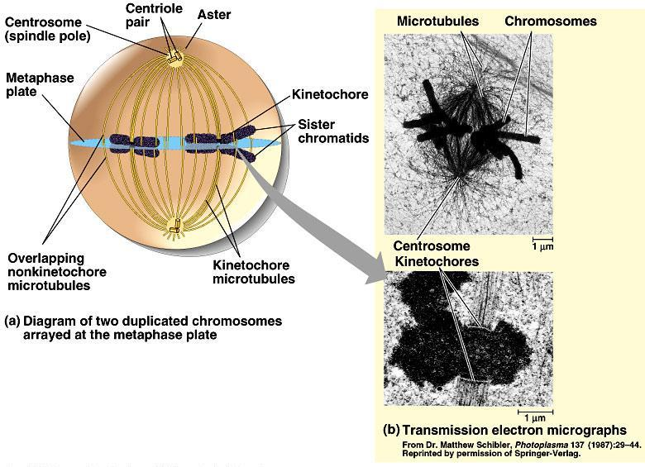
Notes:
*

Slide 24
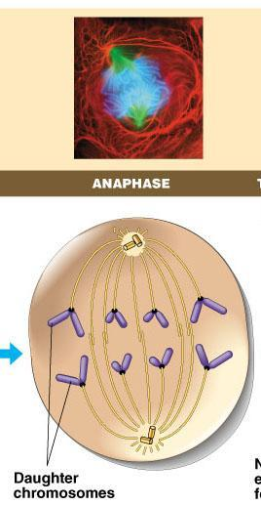
Anaphase
Sister chromatids separate at kinetochores
move to opposite poles
pulled at centromeres
pulled by motor proteins “walking”along microtubules
actin, myosin
increased production of ATP by mitochondria
Poles move farther apart
polar microtubules lengthen
Notes:
*

Slide 25
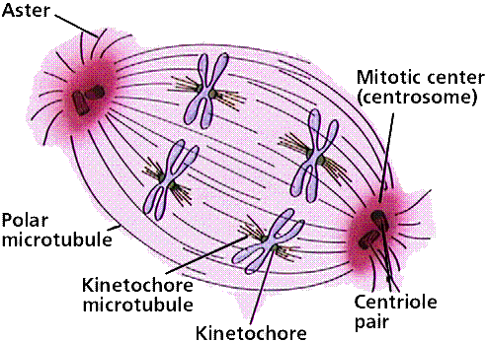
Separation of chromatids
In anaphase, proteins holding together sister chromatids are inactivated
separate to become individual chromosomes
1 chromosome
2 chromatids
2 chromosomes
single-stranded
double-stranded
Notes:
*

Slide 26
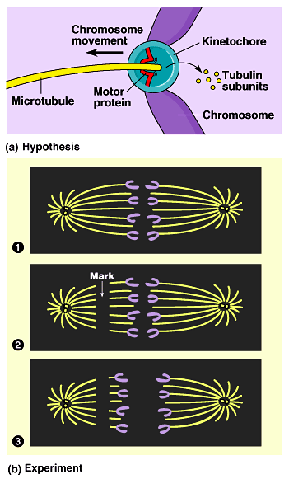
Chromosomes move!
Kinetochores use motor proteins that “walk” chromosome along attached microtubule
Microtubule shortens by dismantling (depolimerizing!) at the kinetochore end
Notes:
*
Microtubules are NOT reeled in to centrioles like line on a fishing rod.
The motor proteins walk along the microtubule like little hanging robots on a clothes line.
In dividing animal cells, non-kinetochore microtubules are responsible for elongating the whole cell during anaphase, readying fro cytokinesis

Slide 27
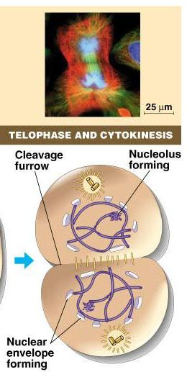
Telophase
Chromosomes arrive at opposite poles
daughter nuclei form
nucleoli form
chromosomes disperse
no longer visible under light microscope
Spindle fibers disperse
Cytokinesis begins
cell division
Notes:
*

Slide 28
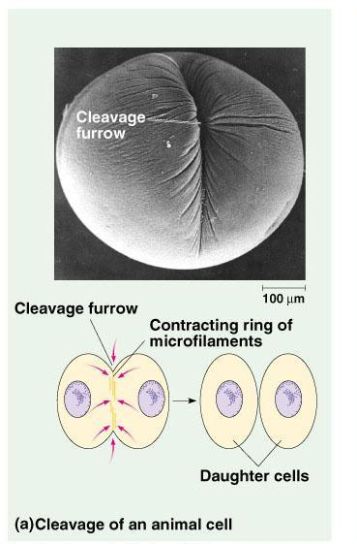
Cytokinesis
Animals
form a cleavage furrow
constriction belt of actin microfilaments around equator of cell
splits cell in two
like tightening a belt around a balloon
Notes:
*
Division of cytoplasm happens quickly.

Slide 29
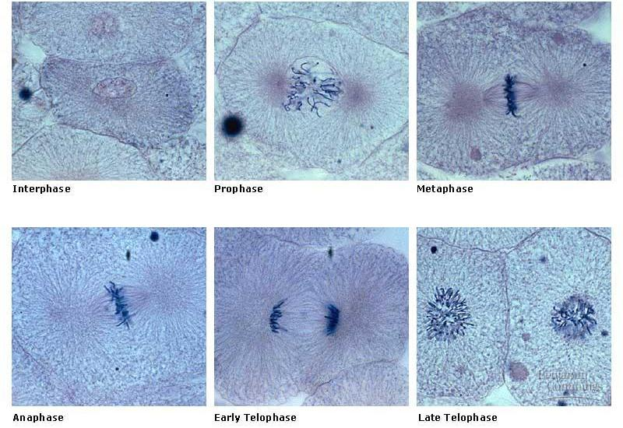
Mitosis in whitefish blastula
Notes:
*

Slide 30
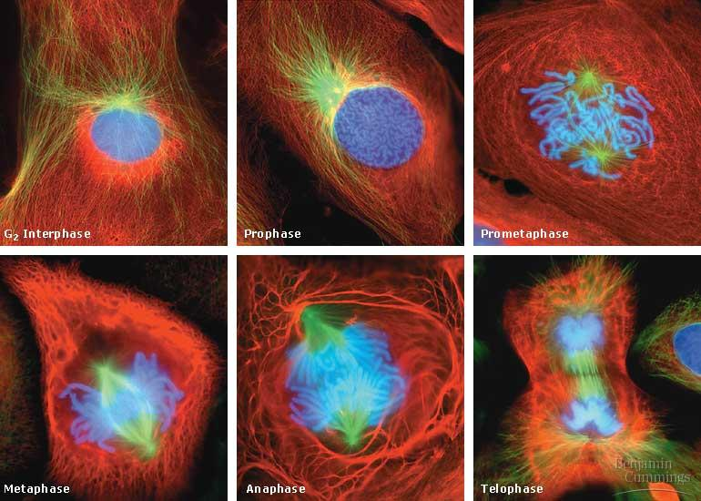
Mitosis in animal cells
Notes:
*

Slide 31
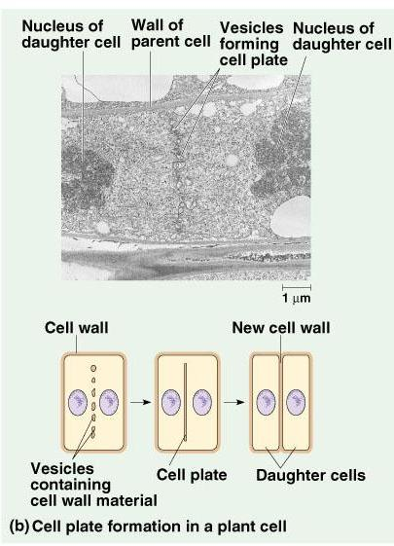
Cytokinesis in Plants
Cell plate
vesicles (derived from Golgi) line up at equator
vesicles fuse to form new cell wall
Notes:
*

Slide 32
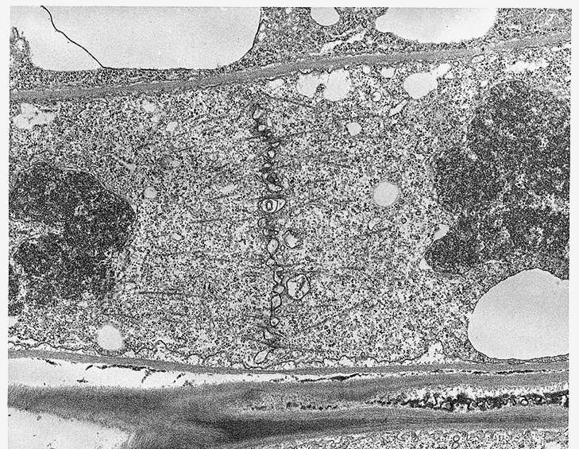
Cytokinesis in plant cell
Notes:
*

Slide 33
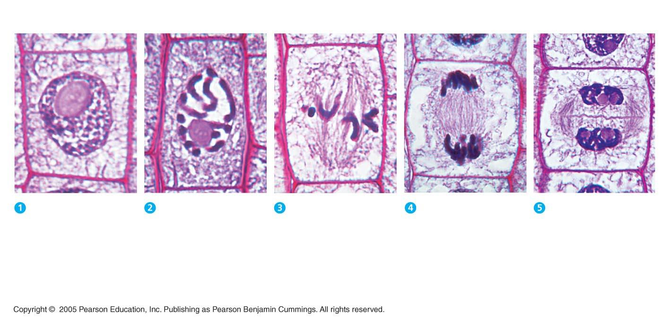
Cell Cycle in Plants
Nucleus
Chromatin
condensing
10 µm
Nucleolus
Chromosomes
Cell plate
Prophase. The
chromatin is condensing.
The nucleolus is beginning to disappear.
Although not yet visible in the micrograph, the mitotic spindle is starting to form.
Prometaphase. We
now see discrete chromosomes; each
consists of two identical sister chromatids. Later
in prometaphase, the
nuclear envelope will fragment.
Metaphase. The spindle is complete, and the chromosomes, attached to microtubules at their kinetochores, are all at
the metaphase plate.
Anaphase. The
chromatids of each chromosome have separated, and the daughter chromosomes are moving to the ends of the cell as their kinetochore micro-
tubules shorten.
Telophase. Daughter nuclei are forming. Meanwhile, cytokinesis has started: The cell plate, which will divide the cytoplasm in two, is growing toward the perimeter of the parent cell.

Slide 34
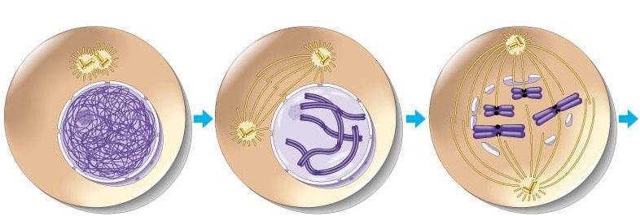
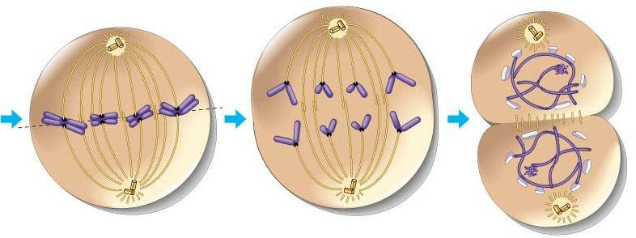
Overview of Cell Cycle
interphase
prophase
(pro-metaphase)
metaphase
anaphase
telophase

Slide 35
Binary Fission
Prokaryotes (bacteria and archaea) reproduce by a type of cell division called binary fission
In binary fission, the chromosome replicates (beginning at the origin of replication), and the two daughter chromosomes actively move apart

Slide 36
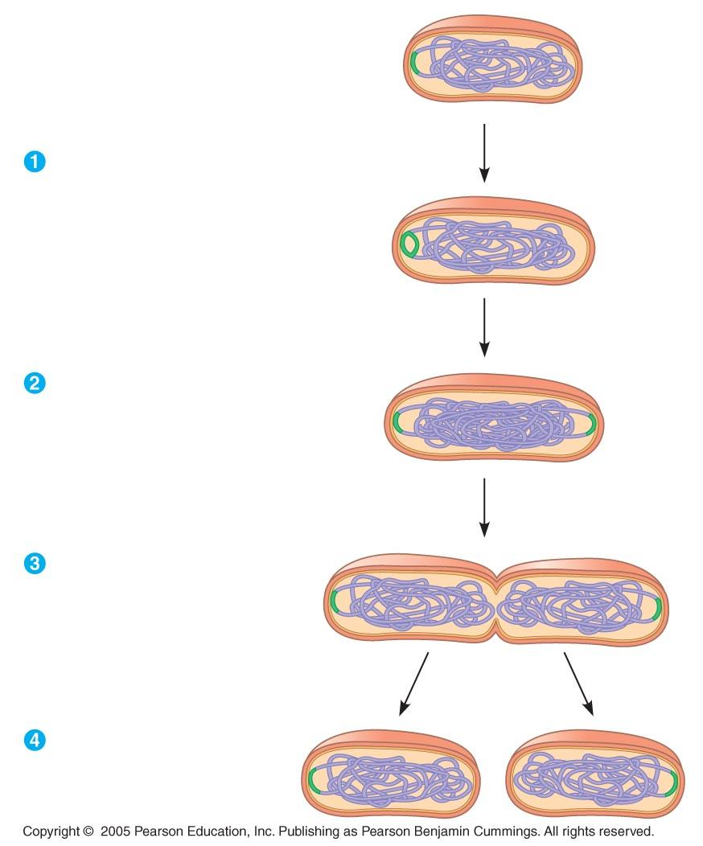
Binary Fission in Prokaryotes
Origin of
replication
Cell wall
Plasma
membrane
E. coli cell
Bacterial
chromosome
Chromosome replication begins.
Soon thereafter,
one copy of the origin moves rapidly toward the other end of the cell.
Two copies
of origin
Replication continues. One copy of the origin is now at each end of the cell.
Origin
Origin
Replication finishes.
The plasma membrane grows inward, and
new cell wall is deposited.
Two daughter
cells result.

Slide 37
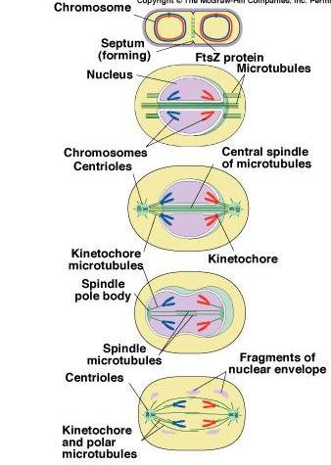
Evolution of Mitosis
prokaryotes
(bacteria)
A possible progression of mechanisms intermediate between binary fission & mitosis seen in modern organisms
protists dinoflagellates
protists diatoms
eukaryotes
yeast
eukaryotes
animals
Notes:
*
Prokaryotes (bacteria)
No nucleus; single circular chromosome. After DNA is replicated, it is partitioned in the cell. After cell elongation, FtsZ protein assembles into a ring and facilitates septation and cell division.
Protists (dinoflagellates)
Nucleus present and nuclear envelope remains intact during cell division. Chromosomes linear. Fibers called microtubules, composed of the protein tubulin, pass through tunnels in the nuclear membrane and set up an axis for separation of replicated
chromosomes, and cell division.
Protists (diatoms)
A spindle of microtubules forms between two pairs of centrioles at
opposite ends of the cell. The spindle passes through one tunnel in the intact nuclear envelope. Kinetochore microtubules form between kinetochores on the chromosomes and the spindle
poles and pull the chromosomes to each pole.
Eukaryotes (yeast)
Nuclear envelope remains intact; spindle microtubules form inside the nucleus between spindle pole bodies. A single kinetochore microtubule attaches to each chromosome and pulls each to a pole.
Eukaryotes (animals)
Spindle microtubules begin to form between centrioles outside of nucleus. As these centrioles move to the poles, the nuclear envelope breaks down, and kinetochore microtubules attach kinetochores of chromosomes to spindle poles. Polar microtubules extend toward the center of the cell and overlap.

Slide 38
Control of cell division
How do cells know when to divide?
cell communication signals
chemical signals in cytoplasm give cue
signals usually mean proteins
Activator proteins
Inhibitor Proteins
Notes:
*

Slide 39
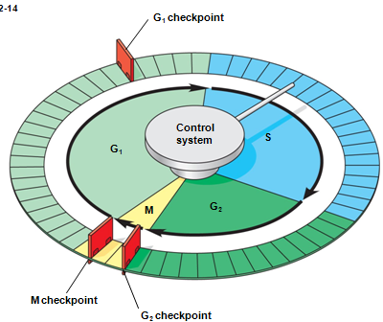
Control of the Cell Cycle: a molecular control system
The frequency of cell division varies with the type of cell
Cell cycle is regulated at the molecular level
Cell cycle is driven by specific chemical signals present in the cytoplasm
The cell cycle has specific checkpoints where the cell cycle stops until a go-ahead signal is received

Slide 40
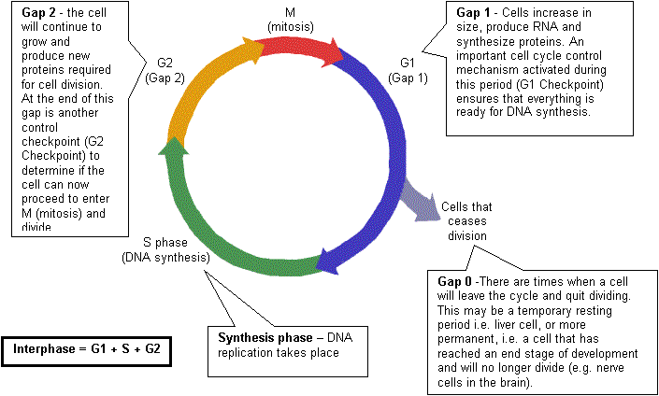
Control of Cell Cycle
Notes:
*

Slide 41
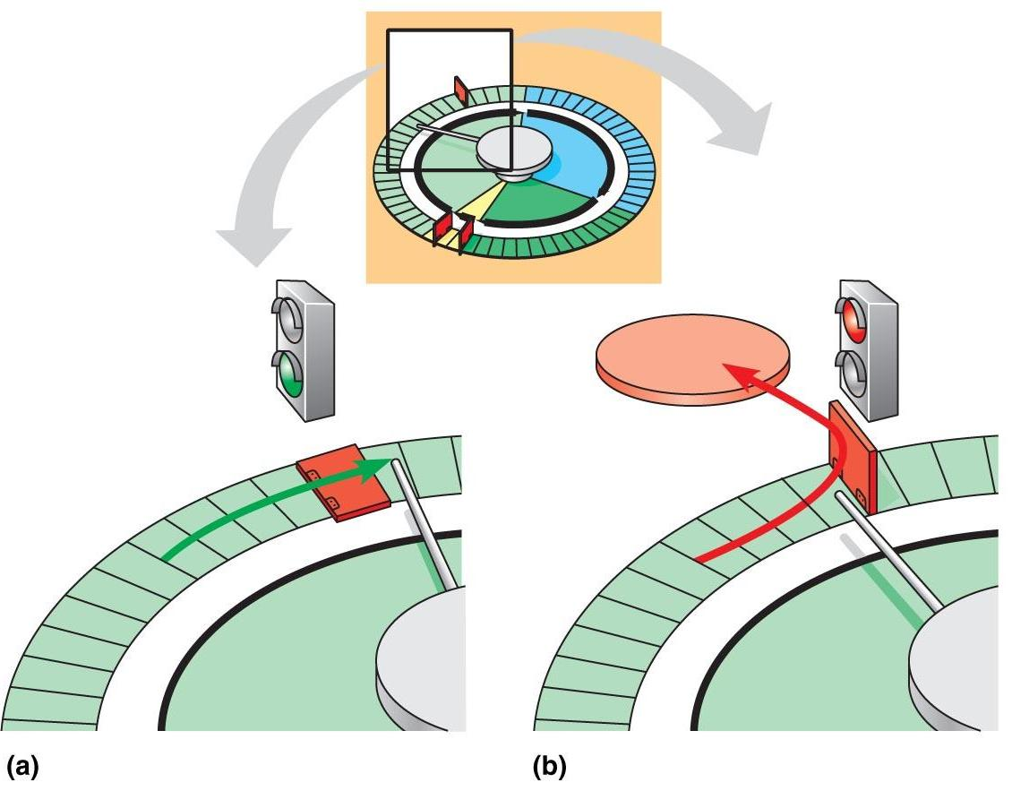
G₁ checkpoint seems to be the most important
If a cell receives a go-ahead signal at the G₁ checkpoint, it will usually complete the S, G₂, and M phases and divide
If the cell does not receive the go-ahead signal, it will exit the cycle, switching into a nondividing state called the G₀ phase
(ex: muscle and nervous system cells)

Slide 42
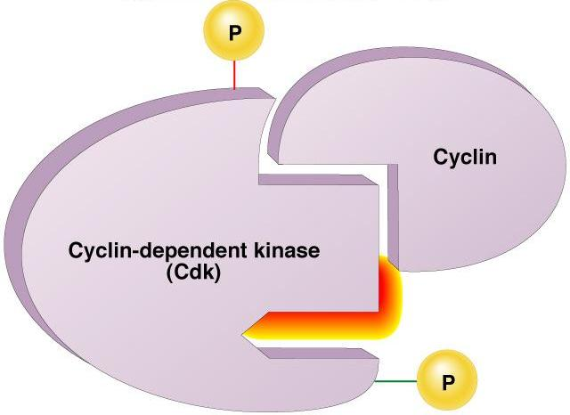
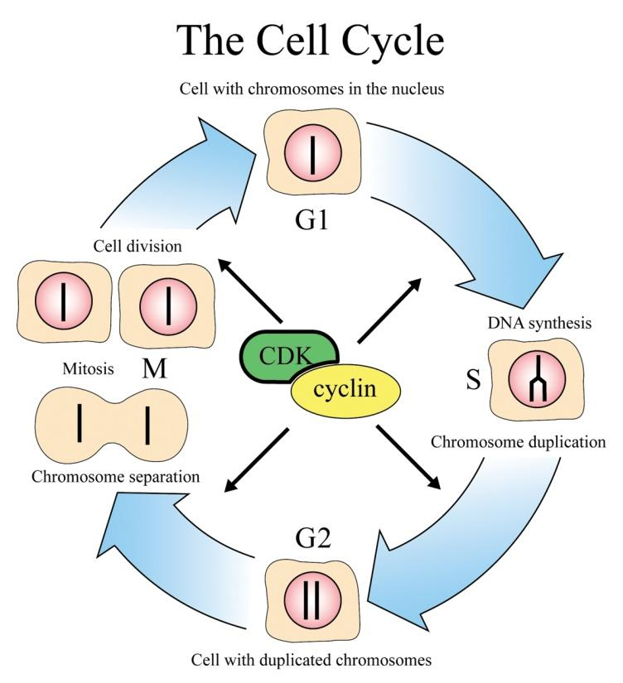
Internal signals
Cell cycle controls:
cyclins
regulatory proteins
level cycle in the cell
Cdks
Cyclin-dependent kinases
Phosphorylate cellular proteins
(activates or inactivates proteins)
Cdk-cyclin complex
triggers passage through
different stages of cell cycle
Notes:
*

Slide 43
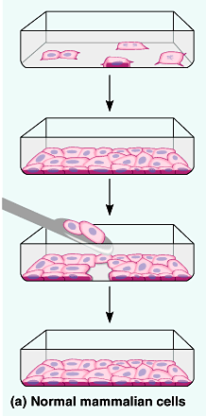
External signals
Growth factors
Protein signals released by body cells that stimulate other cells to divide
For example, platelet-derived growth factor (PDGF) made by platelets in blood clots stimulates cell division in connective tissue -- heal wounds
Density-dependent inhibition
crowded cells stop dividing
Anchorage dependence
to divide cells must be attached to a substrate
Notes:
*

Slide 44
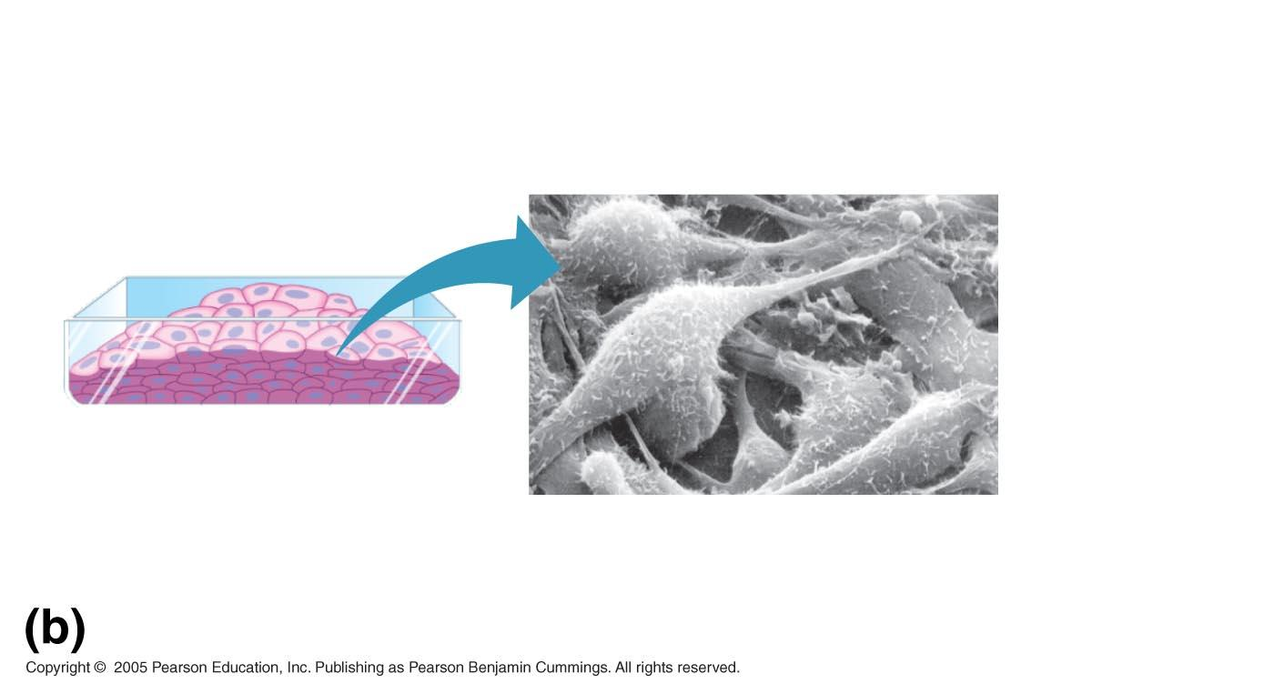
Cancer cells do not exhibit
anchorage dependence
or density-dependent inhibition
Cancer cells lost control of their cell cycle
25 µm
Cancer cells

Slide 45
Tumor: a mass of abnormal cells
Benign tumor
abnormal cells remain at original site as a lump
most do not cause serious problems & can be removed by surgery
Malignant tumor
cells leave original site
lose attachment to nearby cells
carried by blood & lymph system to other tissues
start more tumors = metastasis
impair functions of organs throughout body
since they lost control, cancer cells are more “interested” in dividing than in doing their JOB – G1 phase)
Notes:
*

Slide 46
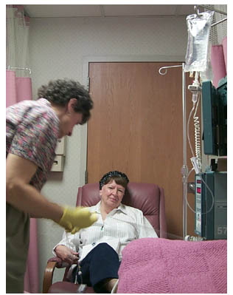
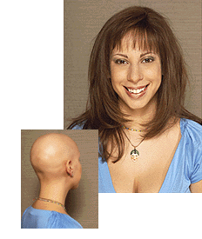
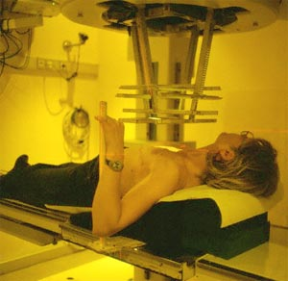
Traditional treatments for cancers
Treatments target rapidly dividing cells
a. High-energy radiation: kills rapidly dividing cells
b. Chemotherapy: “chemical compounds”
- stop DNA replication
- stop mitosis & cytokinesis
- stop blood vessel growth
Notes:
*

Slide 47
http://www.mayoclinic.com/health/cancer/MM00638
2 min
http://highered.mcgraw-hill.com/sites/9834092339/student_view0/chapter10/animation_-_cell_division.html
3 min
http://highered.mcgraw-hill.com/sites/9834092339/student_view0/chapter10/how_the_cell_cycle_works.html
3 min- take quiz and record grade
http://highered.mcgraw-hill.com/sites/9834092339/student_view0/chapter10/control_of_the_cell_cycle.html
3 min-take quiz and record grade

