Slide 1
Genetic Disorders
Inheritance of Genetic Traits

Slide 2
Genetic Disorders

Slide 3
Mutations
Gene mutations can be either inherited from a parent or acquired.
Hereditary mutations are also called germ line mutations because the gene change exists in the reproductive cells and can be passed from generation to generation
Moreover, the mutation is copied every time body cells divide

Slide 4
Mutations occur all the time in every cell in the body. Each cell, however, has the remarkable ability to recognize mistakes and fix them before it passes them along to its descendants.
But a cell's DNA repair mechanisms can fail, or be overwhelmed, or become less efficient with age. Over time, mistakes can accumulate.

Slide 5
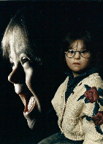
Down’s Syndrome
Caused by non-disjunction of the 21st chromosome.
This means that the individual has a trisomy (3 – 2lst chromosomes).

Slide 6
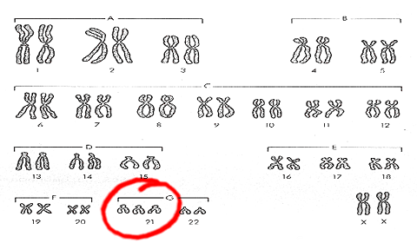
Down’s Syndrome or Trisomy 21

Slide 7
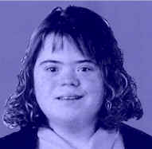
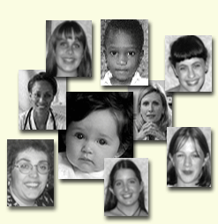

Slide 8
Symptoms of Down Syndrome
Upward slant to eyes.
Small ears that fold over at the top.
Small, flattened nose.
Small mouth, making tongue appear large.
Short neck.
Small hands with short fingers.

Slide 9
Symptoms of Down Syndrome
Low muscle tone.
Single deep crease across center of palm.
Looseness of joints.
Small skin folds at the inner corners of the eyes.
Excessive space between first and second toe.
In addition, down syndrome always involves some degree of mental retardation, from mild to severe. In most cases, the mental retardation is mild to moderate.

Slide 10
Kleinfelter’s syndrome (or Klinefleter’s)
Disorder occurring due to nondisjunction of the X chromosome.
The Sperm containing both X and Y combines with an egg containing the X, results in a male child.
The egg may contribute the extra X chromosome.

Slide 11
XXY
Males with some development of breast tissue normally seen in females.
Little body hair is present, and such person are typically tall, have small testes.
Infertility results from absent sperm.
Evidence of mental retardation may or may not be present.

Slide 12
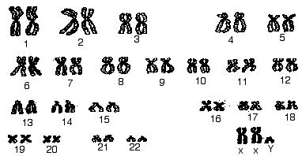

Slide 13
Turner’s
Turner syndrome is associated with underdeveloped ovaries, short stature, webbed, and is only in women.
Bull neck, and broad chest. Individuals are sterile, and lack expected secondary sexual characteristics.
Mental retardation typically not evident.
Chromosomal or monogenic?

Slide 14
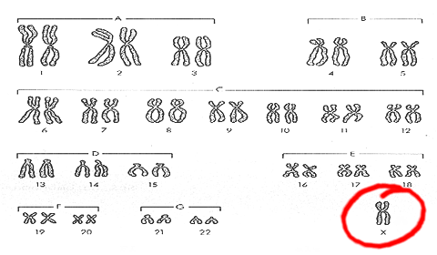
Turner’s Syndrome

Slide 15
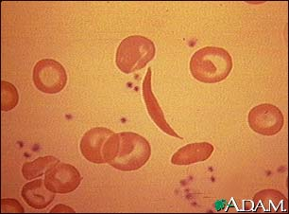
Sickle Cell Anemia
An inherited, chronic disease in which the red blood cells, normally disc-shaped, become crescent shaped. As a result, they function abnormally and cause small blood clots. These clots give rise to recurrent painful episodes called "sickle cell pain crises".

Slide 16
Sickle Cell
Sickle cell disease is most commonly found in African American populations. This disease was discovered over 80 years ago, but has not been given the attention it deserves.

Slide 17
Cystic Fibrosis (CF)
Monogenic
Cause: deletion of only 3 bases on chromosome 7
Fluid in lungs, potential respiratory failure
Common among Caucasians…1 in 20 are carriers
Therefore is it dominant or recessive?

Slide 18
Tay-Sachs disease
Monogenic, autosomal recessive
Central nervous system degrades, ultimately causing death.
Most common among people of Jewish, eastern Europe descent.

Slide 19
Muscular Dystrophy
What Is Muscular Dystrophy? Muscular dystrophy is a disease in which the muscles of the body get weaker and weaker and slowly stop working because of a lack of a certain protein (see the relationship to genetics?)
Can be passed on by one or both parents, depending on the form of MD (therefore is autosomal dominant and recessive)

Slide 20
Hemophilia, the royal disease
Hemophilia is the oldest known hereditary bleeding disorder.
Caused by a recessive gene on the X chromosome.
There are about 20,000 hemophilia patients in the United States.
One can bleed to death with small cuts.
The severity of hemophilia is related to the amount of the clotting factor in the blood. About 70% of hemophilia patients have less than one percent of the normal amount and, thus, have severe hemophilia.

Slide 21
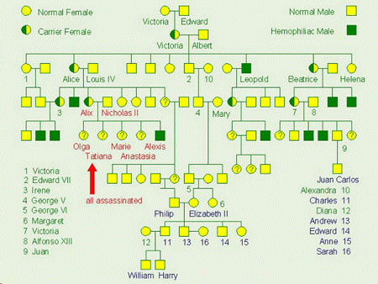
X-linked Inheritance pedigree chart

Slide 22
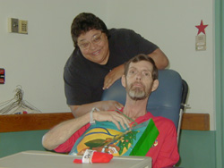
Huntington’s Disease
Huntington's disease (HD) is an inherited, degenerative brain disorder which results in an eventual loss of both mental and physical control. The disease is also known as Huntington's chorea. Chorea means "dance-like movements" and refers to the uncontrolled motions often associated with the disease.

Slide 24
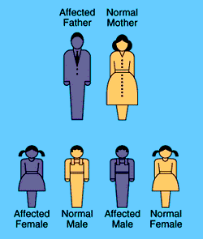

Slide 25
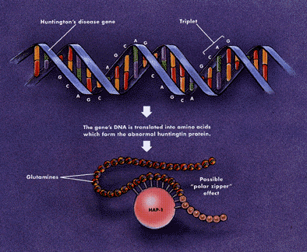
Huntington’s
Looking back at the pedigree chart is Huntington’s dominant or recessive?
Scientists have discovered that the abnormal protein produced by the Huntington's disease gene, which contains an elongated stretch of amino acids called glutamines, binds more tightly to HAP-1 than the normal protein does.

Slide 26
Phenylketonuria or PKU
People with PKU cannot consume any product that contains aspartame.
PKU is a metabolic disorder that results when the PKU gene is inherited from both parents (recessive or dominant? Monogenic or chromosomal?)
Caused by a deficiency of an enzyme which is necessary for proper metabolism of an amino acid called phenylalanine.

Slide 27
PKU
Phenylalanine is an essential amino acid and is found in nearly all foods which contain protein, dairy products, nuts, beans, tofu… etc.
A low protein diet must be followed.
Brain damage can result if the diet is not followed causing mental retardation…and mousy body odor (phenylacetic acid is in sweat).

Slide 28
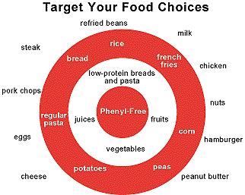
Phenylalanine. Free diet

Slide 29
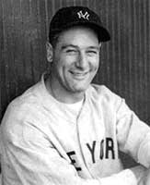
ALS (Amyotrophic Lateral Sclerosis, or Lou Gehrig’s disease)

Slide 30
the disease strikes people between the ages of 40 and 70, and as many as 30,000 Americans have the disease at any given time
This monogenic mutation is believed to make a defective protein that is toxic to motor nerve cells.
A common first symptom is a painless weakness in a hand, foot, arm or leg, other early symptoms include speech swallowing or walking difficulty

Slide 31
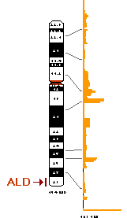
Adenoleukodystrophy
ALD) is a rare, inherited metabolic disorder that afflicts the young boy Lorenzo Odone, whose story is told in the 1993 film 'Lorenzo's oil'. In this disease the fatty covering (myelin sheath) on nerve fibers in the brain is lost, and the adrenal gland degenerates, leading to progressive neurological disability and death.

Slide 32
Lorenzo Odone
The oil came too late to stop his son from developing the symptoms must be hard to bear. Lorenzo lost most of his bodily functions and has been bedridden for 18 years.

Slide 33
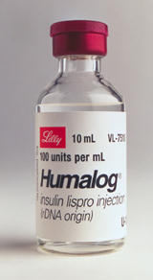
Diabetes
Disease in which the body does
not produce or properly use insulin.
Insulin is a hormone that is needed to convert sugar, starches, and other food into energy needed for daily life.
Genetic mutation can lead to Type 1 diabetes, but no one sure if relative to a specific gene

Slide 34
Diabetes
Type 1 reveals itself in childhood, Type 2 can be made worse from excessive lifestyle
Warning signs
Extreme thirst
Blurry vision from time to time
Frequent urination
Unusual fatigue or drowsiness
Unexplained weight loss
Diabetes is the leading cause of kidney failure, blindness, and amputation in adults, and can also lead to heart disease.

Slide 35
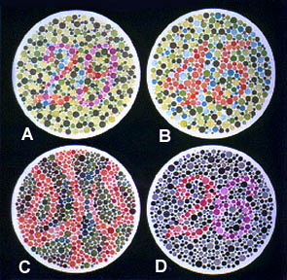
Color Blindness
Cause: x-linked recessive
1/10 males have, 1/100 females have. Why the difference?
Individuals are unable to distinguish shades of red-green.
Are you color blind?

Slide 37
Albinism
Patients are unable to produce skin or eye pigments, and thus are light-sensitive
Autosomal recessive
Therefore, is it monogenic or chromosomal?

Slide 38
Achondroplasia (a.k.a. dwarfism)
Monogenic, autosomal
Carriers express genes, therefore, is it dominant or recessive?
There is also a disease called gigantism (Andre the Giant)

