Slide 1
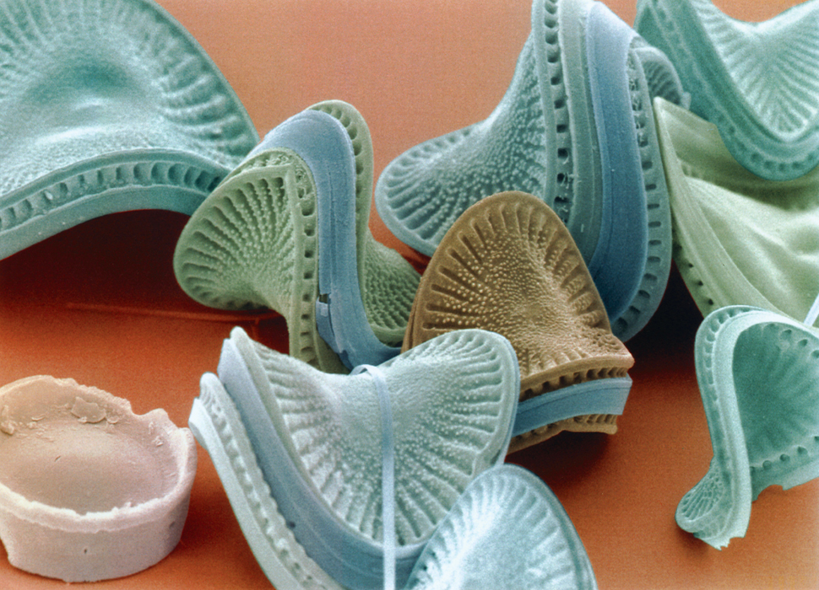
KEY CONCEPT Fermentation allows the production of a small amount of ATP without oxygen.

Slide 2
Fermentation allows Glycolysis to continue making ATP when oxygen is unavailable.
Anaerobic process
Glycolysis will happen the same way it does at the beginning of cellular respiration
Glycolysis splits glucose into two pyruvic acid molecules
Pyruvic acid and NADH enter Fermentation

Slide 3
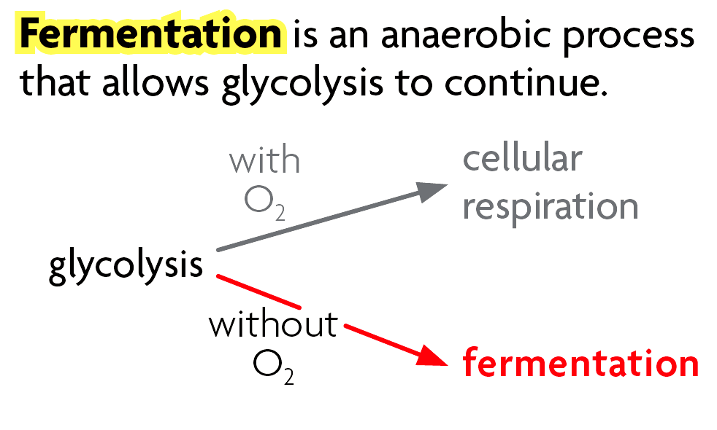
Fermentation will occur instead of cellular respiration due to the lack of oxygen
Occurs in the cytoplasm of cells
Fermentation does not produce ATP

Slide 4
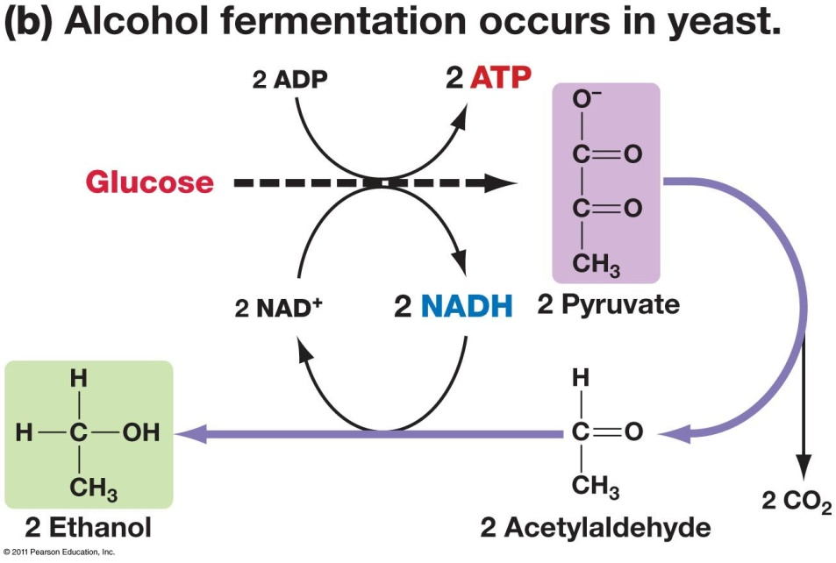
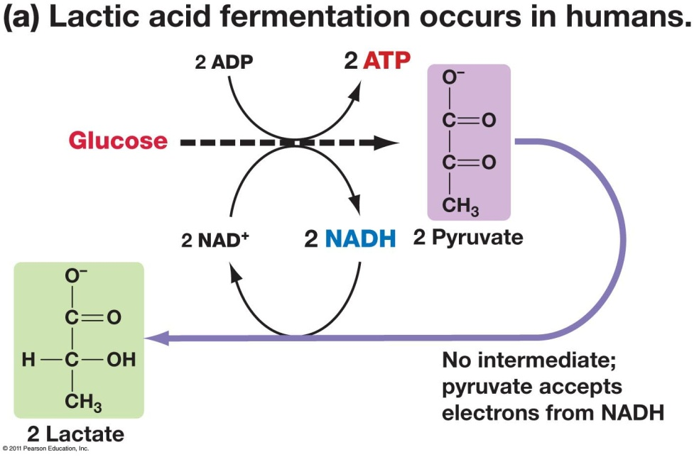
Two Types of Fermentation
Lactic Acid
Alcoholic

Slide 5
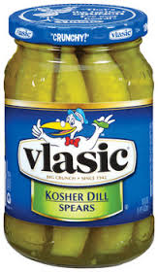
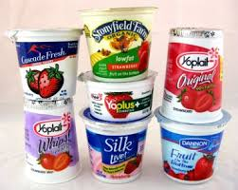
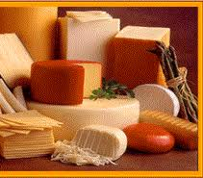
Lactic acid fermentation
occurs in animal muscles when the tissue requires energy at a faster rate than oxygen can be supplied
used to convert lactose into lactic acid in yogurt and cheese production
also gives the sour taste to fermented vegetables such as pickles

Slide 6
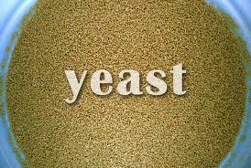
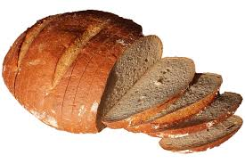
Alcoholic fermentation
Yeast and certain bacteria
Pyruvate is broken into alcohol and carbon dioxide
Used in the production of beer, wine and bread

Slide 7
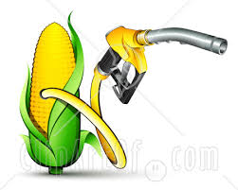
Uses of fermentation in industry
Sewage treatment
Biofuels
Hydrogen gas

