Slide 1
OBJECTIVES
* Journal due Friday!!
Common Assessment
Lipid/Nucleic acid quiz make ups (Keeley, Priscilla, Zach, Ton’Nesha, Teddi)
Make up by Friday or a “0”

Slide 2
BIOCHEMISTRY
Common Assessment Review

Slide 3
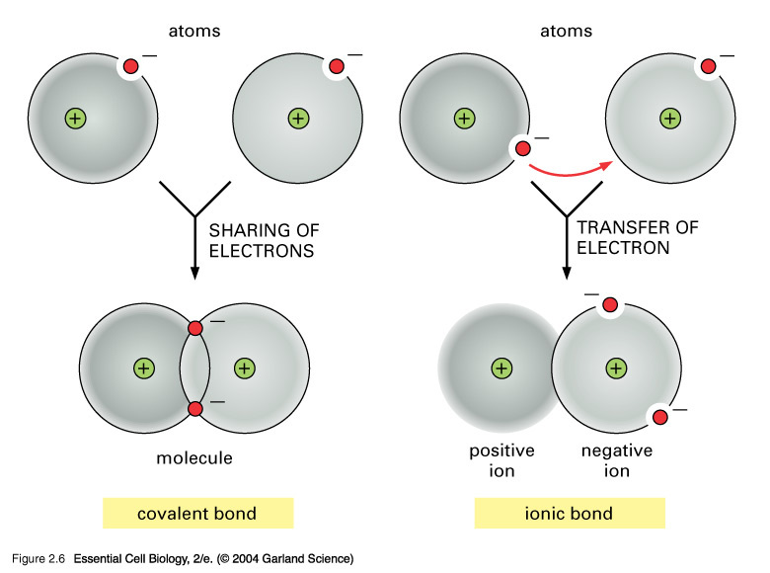
Differences in Bonding??
Covalent
Ionic
Shares electrons
Seen with nonmetals
Carbon
Transfers electrons
Metals & nonmetals

Slide 4
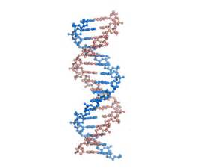
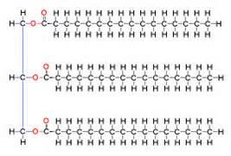
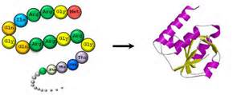
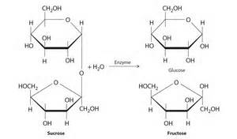
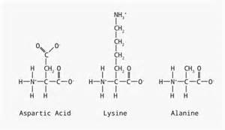
Why is carbon so interesting??
Found in all life forms
Has 4 valence electrons
Covalent bonding

Slide 5
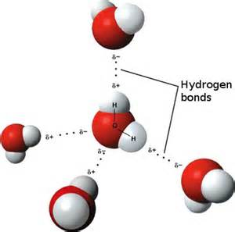
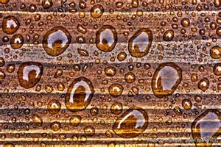
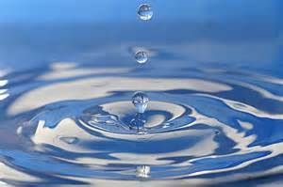
Water properties….
Hydrogen Bonding
cohesion

Slide 6
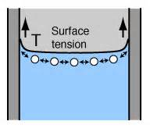
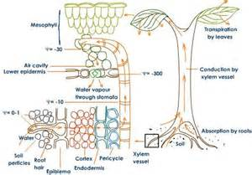
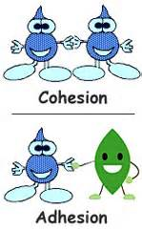
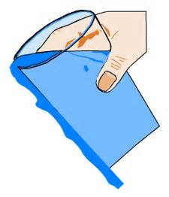
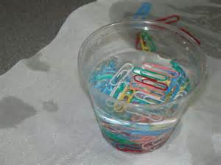
Water properties….
Adhesion

Slide 7
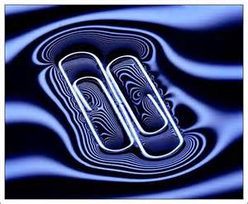
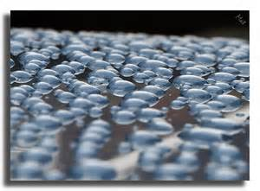
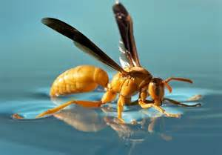
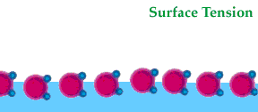
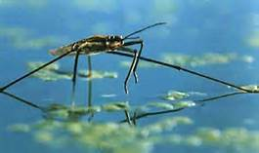
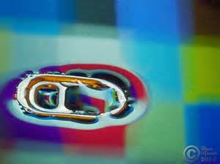
Water properties….. Surface tension

Slide 8
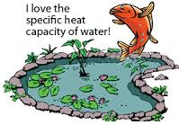
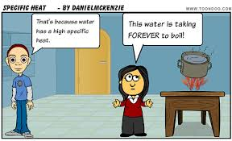
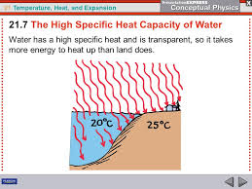
Water properties… High Specific Heat

Slide 9
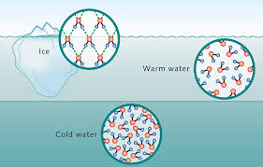
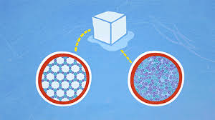
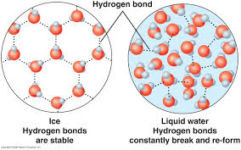
Why does Ice Float?

Slide 10
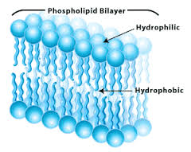
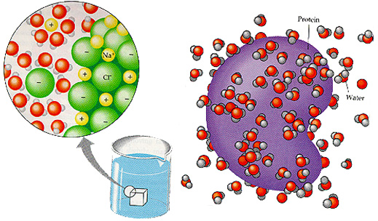
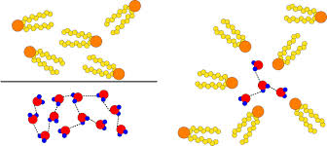
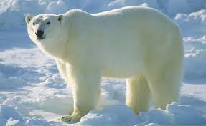
Properties of Water
Hydrophobic - nonpolar
Hydrophilic - polar

Slide 11
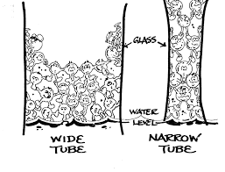
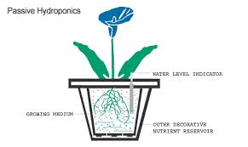
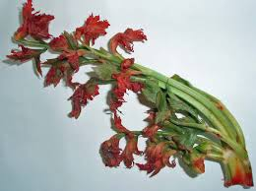
Water properties – capillary action

Slide 12
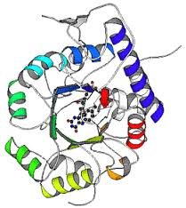
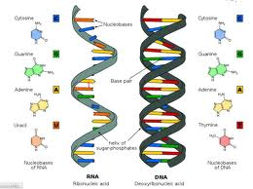
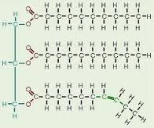
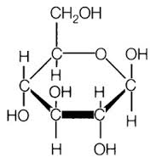
Name four macromolecules you have learned.
Lipids
Carbohydrates
Proteins
Nucleic acids

Slide 13
Name four organic molecules you have learned.
Lipids
Carbohydrates
Proteins
Nucleic acids

Slide 14
Name four biomolecules you have learned.
Lipids
Carbohydrates
Proteins
Nucleic acids

Slide 15
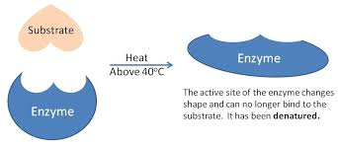
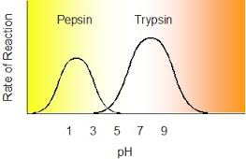
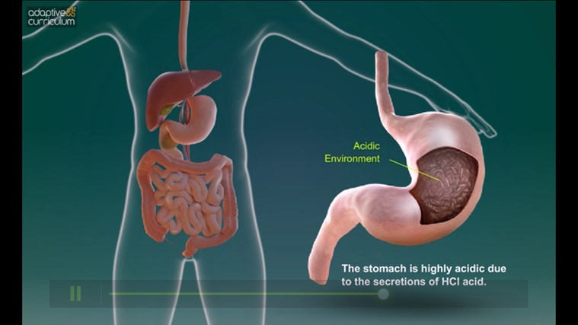
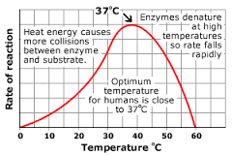
Enzymes – what affects their activity?
Temperature
pH

Slide 16
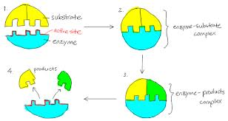
Enzymes – a kind of protein

Slide 17
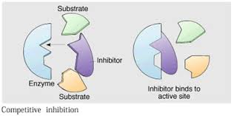
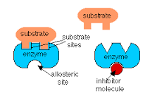
Inhibitors affect enzyme activity
Competitive
Noncompetitive

Slide 18
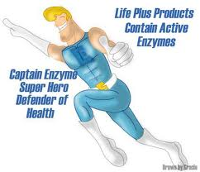
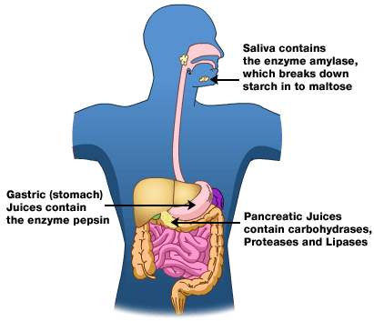
What words are enzymes?
Lipase
Sucrose
Fruitose
Protease
Galactose
Peroxidase

Slide 19
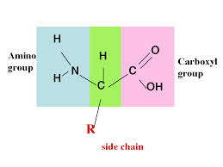
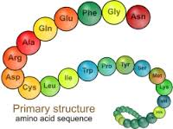
Proteins are made up of amino acids

Slide 20
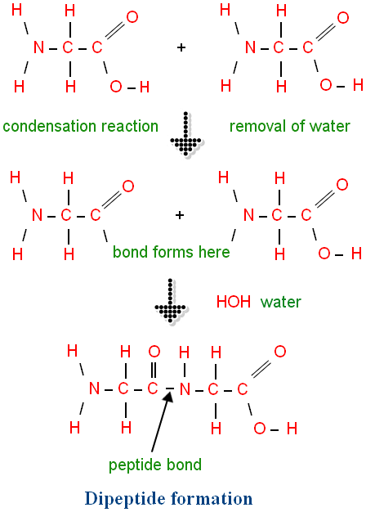

Slide 21
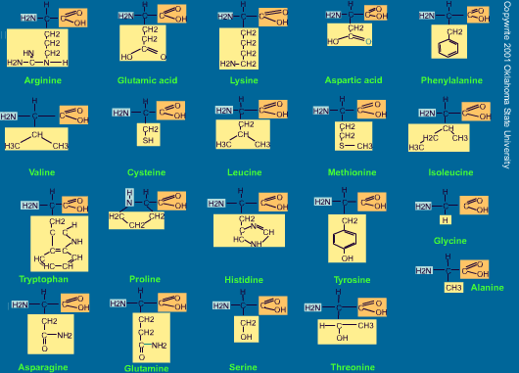
There are 20 different amino acids

Slide 22
Polypeptide chain to protein

Slide 23
Describe the structure & function of a protein
Made up of individual amino acids that connect through peptide bonds to form a polypeptide chain.
Made from the elements, carbon, hydrogen, oxygen, nitrogen & sometimes sulfur
Their function is to regulate cell processes, cell signaling, repair of muscles & development of hair and nails.

Slide 24
Examples of proteins
Hemoglobin
Keratin

Slide 25
Monomers (amino acids) to polymers(protein)

Slide 26
Dehydration synthesis vs hydrolysis
1
2

Slide 27
Carbohydrates - saccharides

Slide 28
Describe the structure and function of a carbohydrate?
Carbohydrates consist of hydrogen, carbon & oxygen. The carbons bond together into the shape of a ring.
Carbohydrates produce energy – short term

Slide 29
What happens to energy that is not used up?
Stored as glycogen (a polysaccharide) in the liver.

Slide 30
Which words represent a type of sugar?
Glucose
Lipase
Alanine
Fructose
Protease
cytosine

Slide 31
Where is cellulose & are we able to digest it?

Slide 32
Carbohydrates - monomers to polymers

Slide 33
Describe the structure of the lipid and determine the function of it?
Lipids are made up of the elements carbon, hydrogen & oxygen. Lipids generally have the shape of a head region (glycerol) and a fatty acid tail region.
The function of a lipid is store long term energy
Fats, oils & waxes are examples!

Slide 34
Types of lipids
Triglycerides
Phospholipids

Slide 35
Where are these types of fats found?
Triglycerides
phospholipids

Slide 36
Saturated & unsaturated
Saturated - animals
Unsaturated - plants

Slide 37
Nucleic acids
DNA
RNA

Slide 38
Describe the structure and function of a nucleic acid.
Nucleic acids are made up of the elements carbon, hydrogen, oxygen, phosphorus & nitrogen. They are made up of nucleotides which consist of a sugar, phosphate & base and they are found in all of our foods
The function is to carry genetic information.

Slide 39
What is the difference between DNA & RNA?

Slide 40
ONE THING TO REMEMBER ABOUT MACROMOLECULES……
Proteins, lipids & carbohydrates are all synthesized from monomers by dehydration synthesis (condensation synthesis)!!
Proteins, lipids & carbohydrate polymers can also be broken down by adding water through hydrolysis!!

